Slide 1
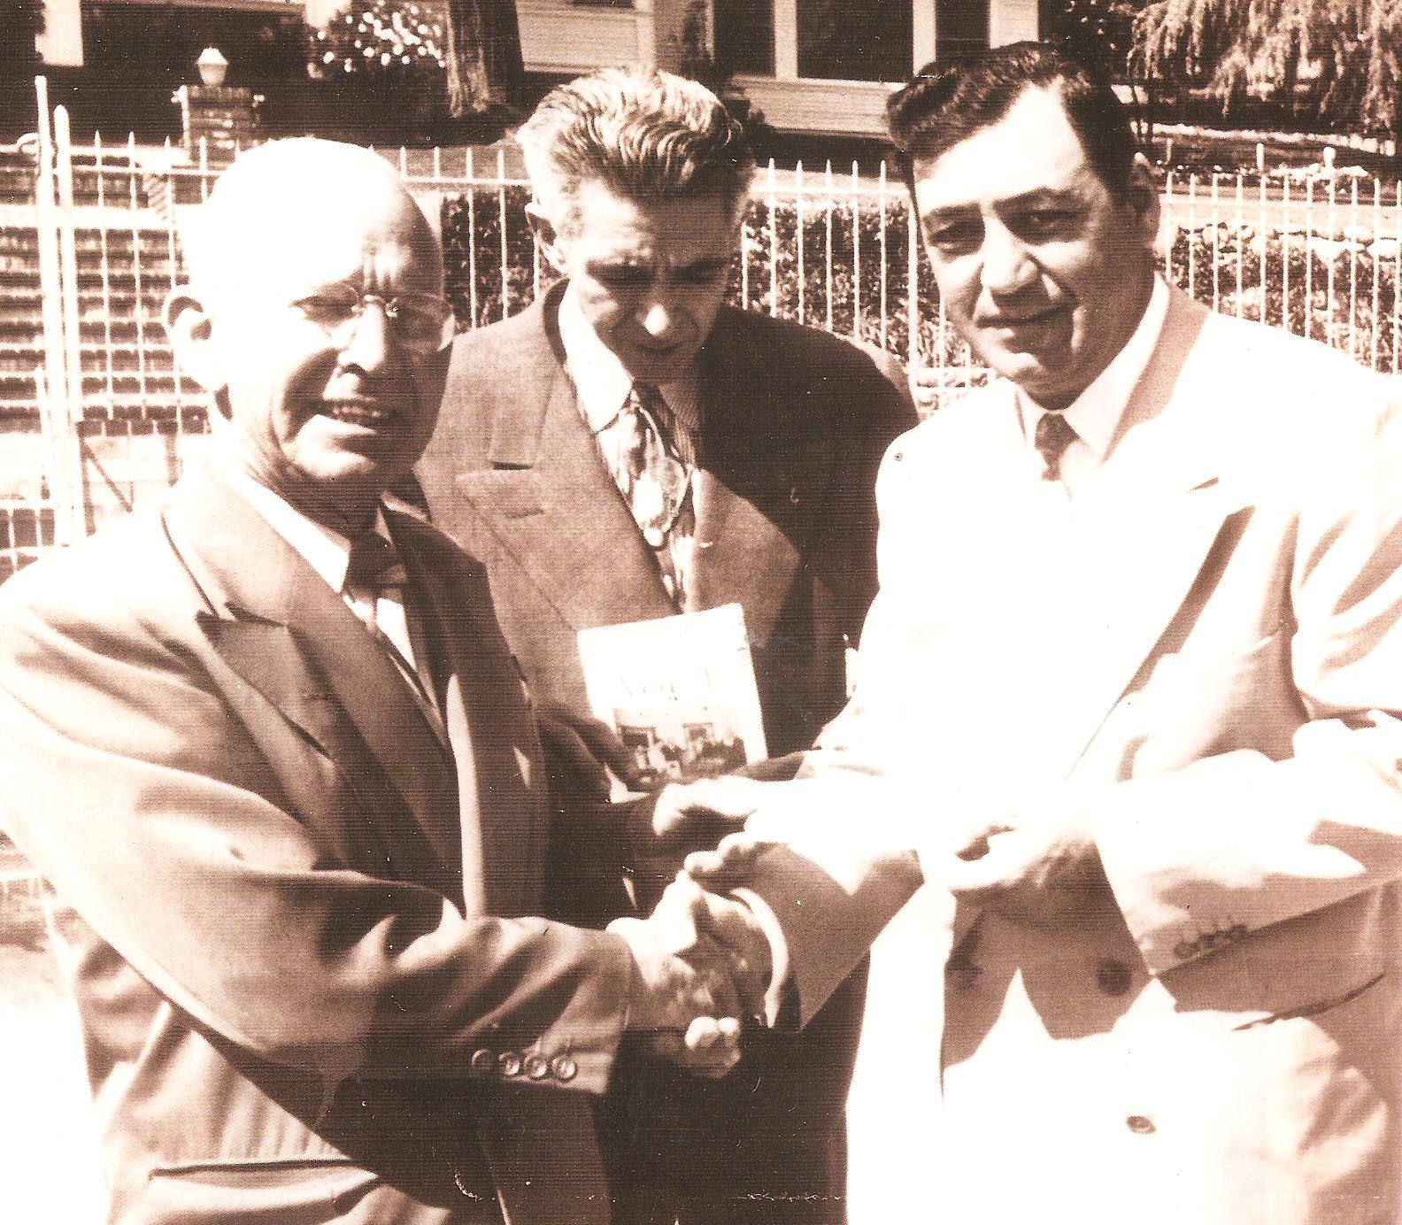
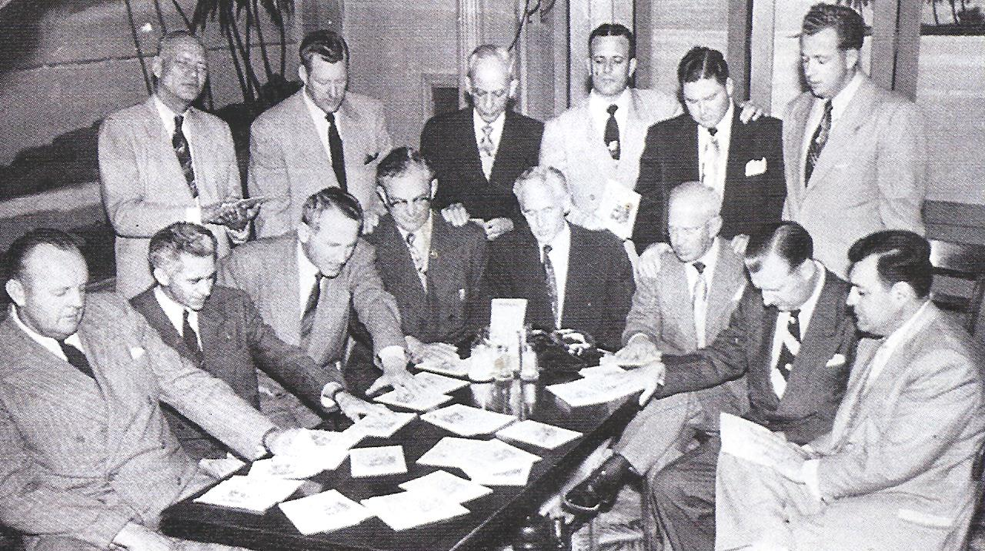
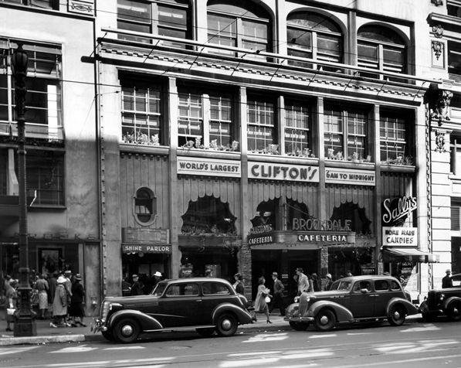
The Full gospel business men fellowship international
How did it start?

Slide 2

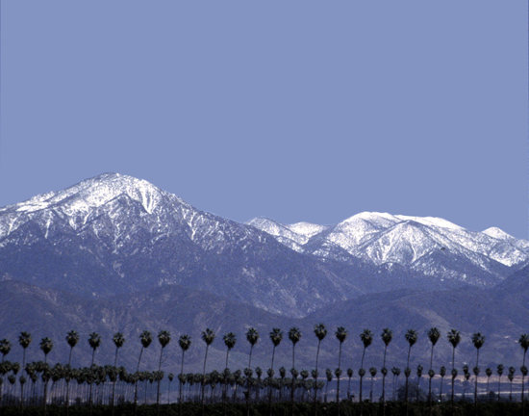
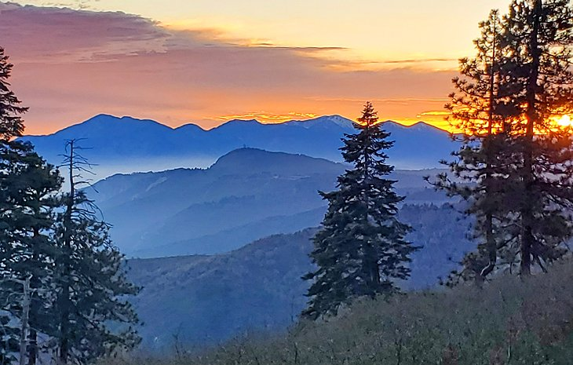
“God has shown me the future, and has revealed that A" New Wave of Revival” is about to EXPLODE within the body of Christ. The powerful miracle VISION God gave me for the Fellowship, and the world, is not over . . . IT HAS JUST BEGUN!”
“All of our meetings, conventions, seminars, and money mean nothing …without the power of the holy spirit!”

Slide 3
FULL GOSPELL BUSINESS MEN’S FELLOWSHIP INTERNATIONAL USA
Our Mission statement
To reach men in all nations for Jesus Christ.
To call men back to God by walking in Love.
To help believers to be baptized in the Holy Spirit.
To Train and equip men to fulfill the Great Commission.
To Provide an opportunity for Christian fellowship.
To bring unity among all people in the body of Christ.
To do the things that Jesus did…even more so. John 14:12

Slide 4
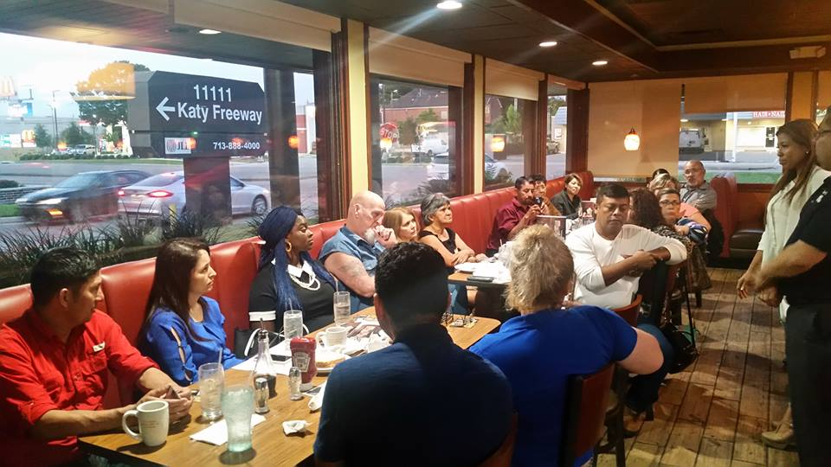
What is a Chapter?
It’s a group of members/believers that meet in a neutral place to share a success story (testimony)…in a business type of atmosphere …nothing religious…so others can come to know our Lord Jesus Christ. We create platforms as to present the Gospel through a testimony.
We are not a church, nor we do want to be one…
Don’t scare the fish away
We are a layman’s ministry/organization .

Slide 5
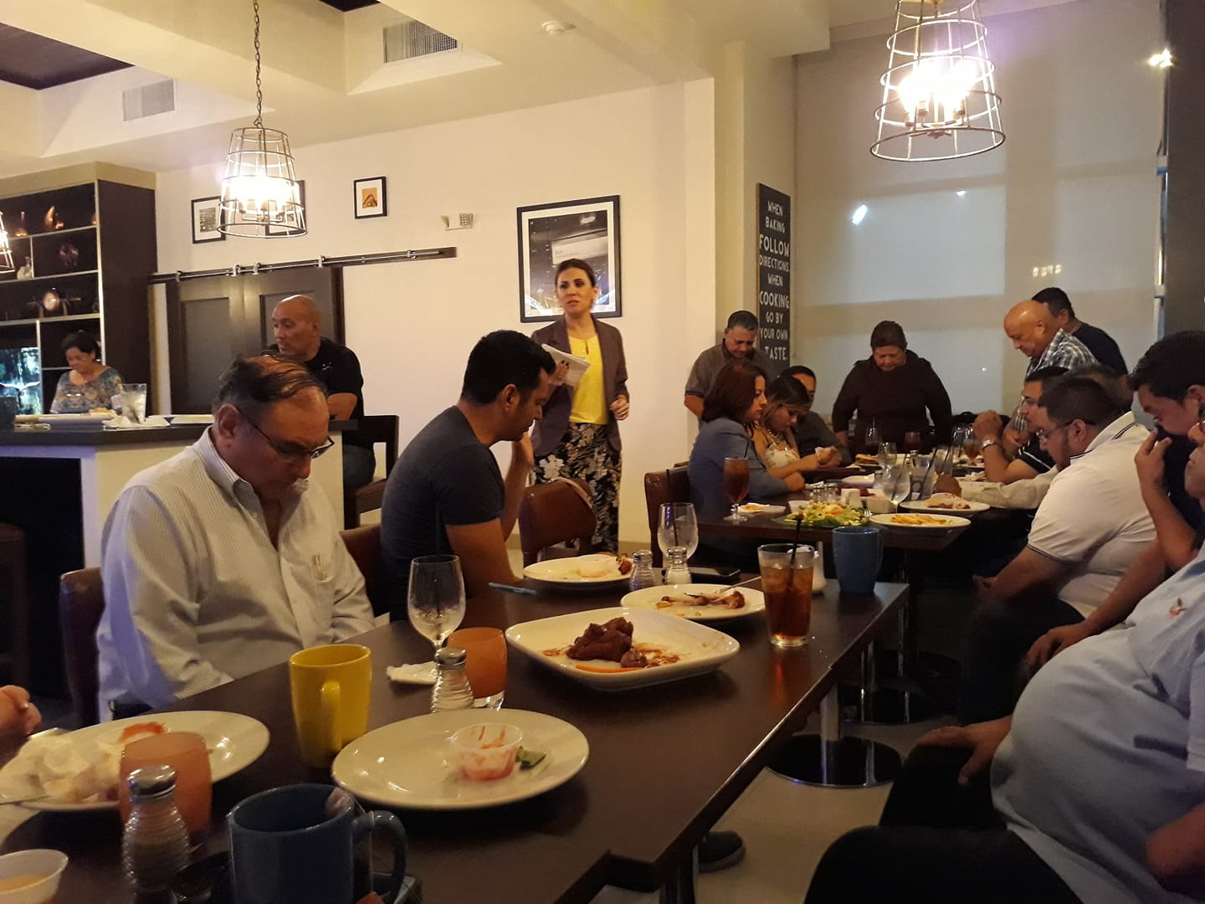
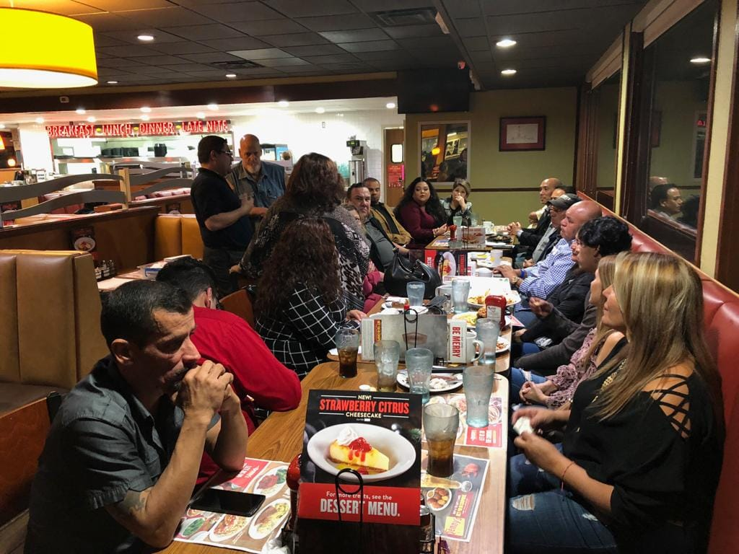
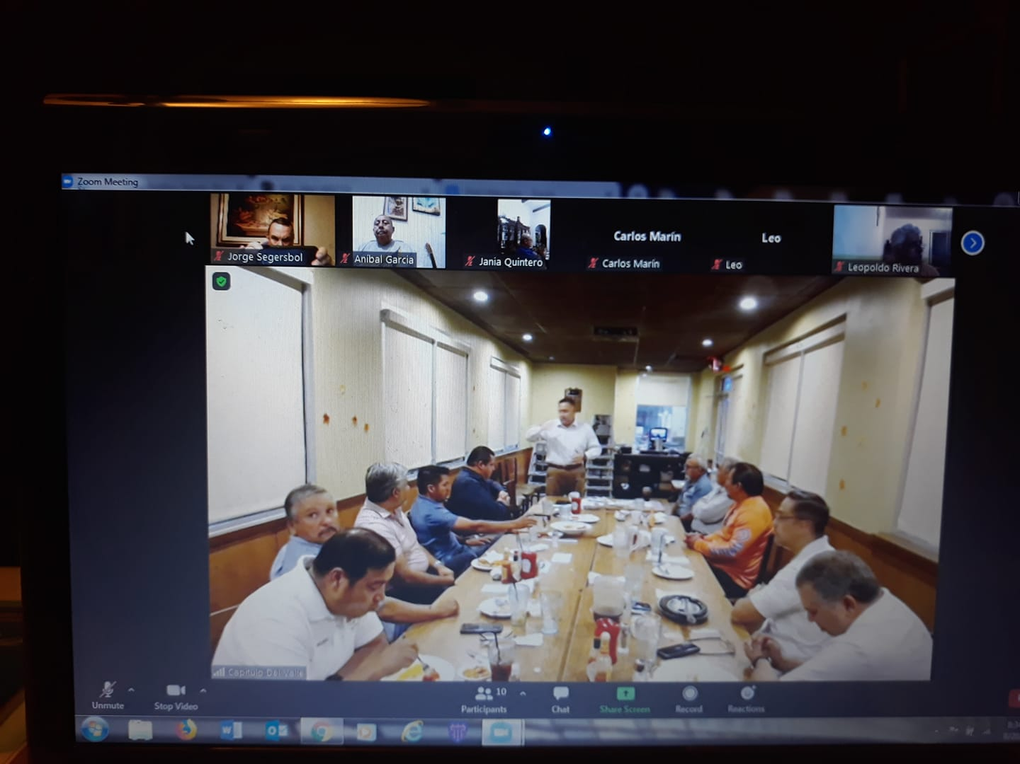
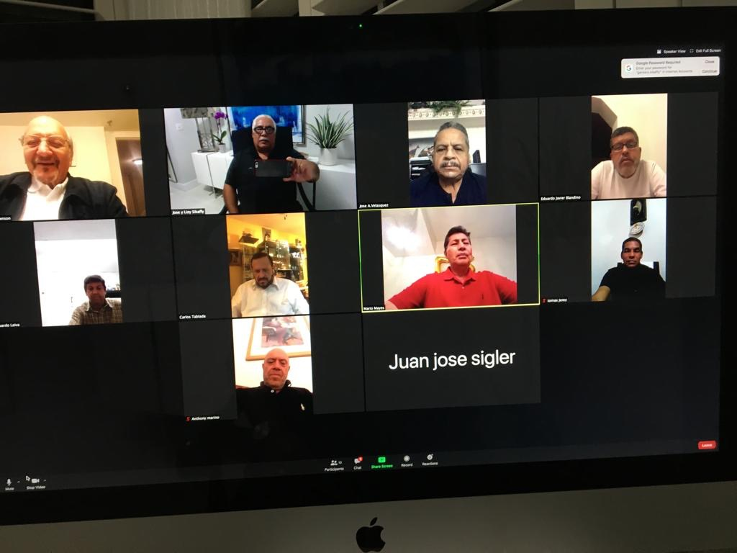
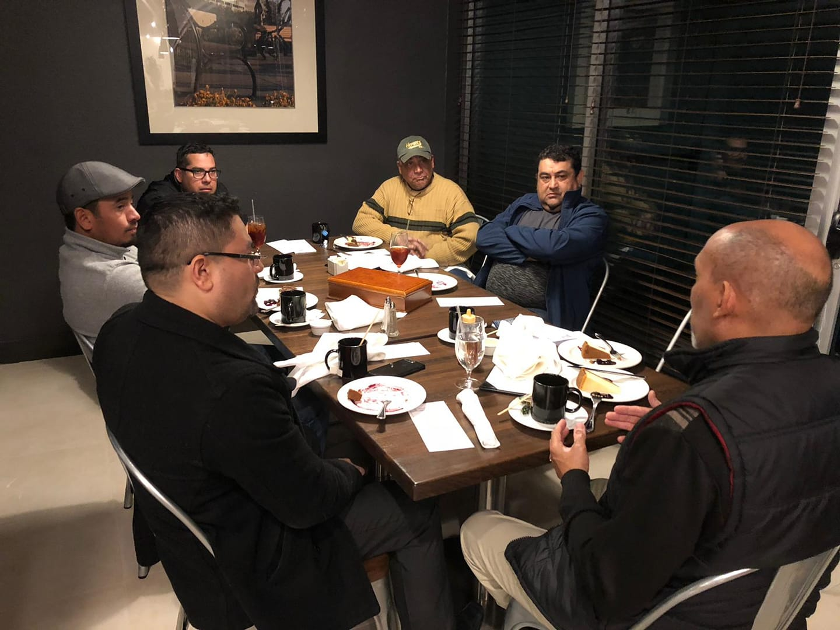
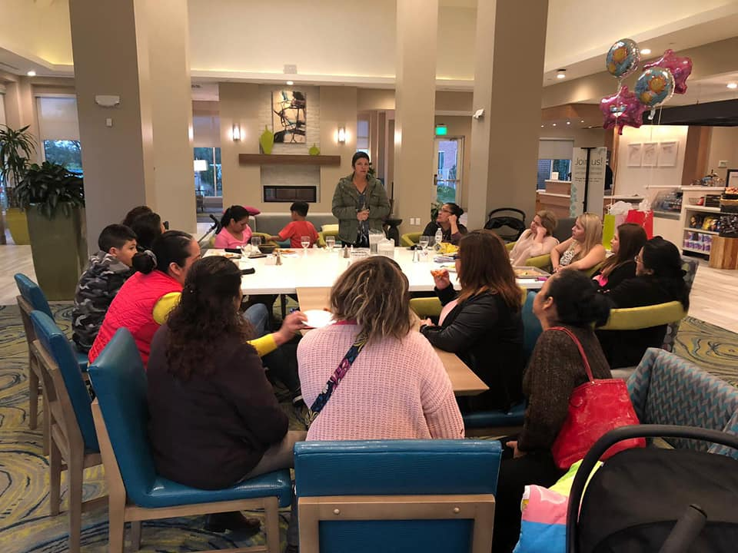
There are many types of chapters, and no two will be the same….the Lord likes the diversity…

Slide 6
Goal of the FGBMFI:
To Win Souls.
… So we custom make/tailor our events according to our audience…including the day of the week and time…among other things…
These meetings are not for us but for the ones that still don’t know whom Jesus Christ is…
We are blessed by listening to the testimonies and the wonderful fellowship…but these are some of the benefits of serving our Lord…plus many, many more…
…and… a chapter in order to be effective should meet at least twice a month…but we could start with one …a beginning is a beginning

Slide 7
So…
The FGBMFI is a strategy and as such we must follow certain guide lines
No preaching…We don’t discuss Theology since we have people/members that come from different denominations/back grounds. We only share/present a Testimony that shows how God can change lives and by doing so we demonstrate that God truly Exists. We do encourage people to attend a church…which one? The one that talks about the Father, the Son and the Holy Spirit …and the one that they feel comfortable wtih.
We don’t do Bible studies although we encourage the members to read it at home or at their respective churches.
We all love God and we would like to praise and worship Him …and there is nothing wrong with that, but this is not the place…
We pray and invite the Holy Sprit to attend before the guests arrive. At the end of the event we pray for anyone that has a need…but at the end…after the testimony and the “altar call” or Invitation to the Cross/Christ.

Slide 8
How do we organize ourselves?
Every chapter should have:
A President.- That ensures that the chapter is fulfilling the mandate, the vision, the mission and the Strategy of FGBMFI. He has the Spiritual responsibility. He elects or approves the guest speakers…he is responsible along with the Treasurer, to oversee the finances…he must have received the baptism of the Holy Spirit. We can also have a Vice President that can assist in every aspect of the functioning of the chapter/event.
A Secretary .- He/She maintains all the chapter records, assists the President in every aspect of the chapter operations, is responsible for all the chapter advertising, websites and all updates. He/She must also have received the baptism of the Holy Spirit.

Slide 9
A Treasurer.- He/She is responsible together with the President for the finances. Must keep a good record of the expenditures / receipts of the paid expenses as well as all the offerings, deposits, and monthly donations to FGBMFI-USA main office.
Other Officers: (not limited to)
Memberships .- Makes sure that these are promoted in every event and maintains a record of the chapter members, notifying members when renewals are needed.
Prayer Coordinator.- He/She is responsible for coordinating prayer meetings. Trains and equips members in Spiritual warfare and intercessory prayer.
Outreaches and expansion- Special events coordinator who seeks and plans Fire Team events and seeks new places to start new chapters.
Books.- Makes sure that there are always books, magazines in the chapter for the members and visitors, to promote chapter growth. Coordinates purchases with the President and Treasurer.

Slide 10

Sometimes it takes time…a tree must first develop a strong root system, so that it will be able to stand against the strong winds that may come…

Slide 11
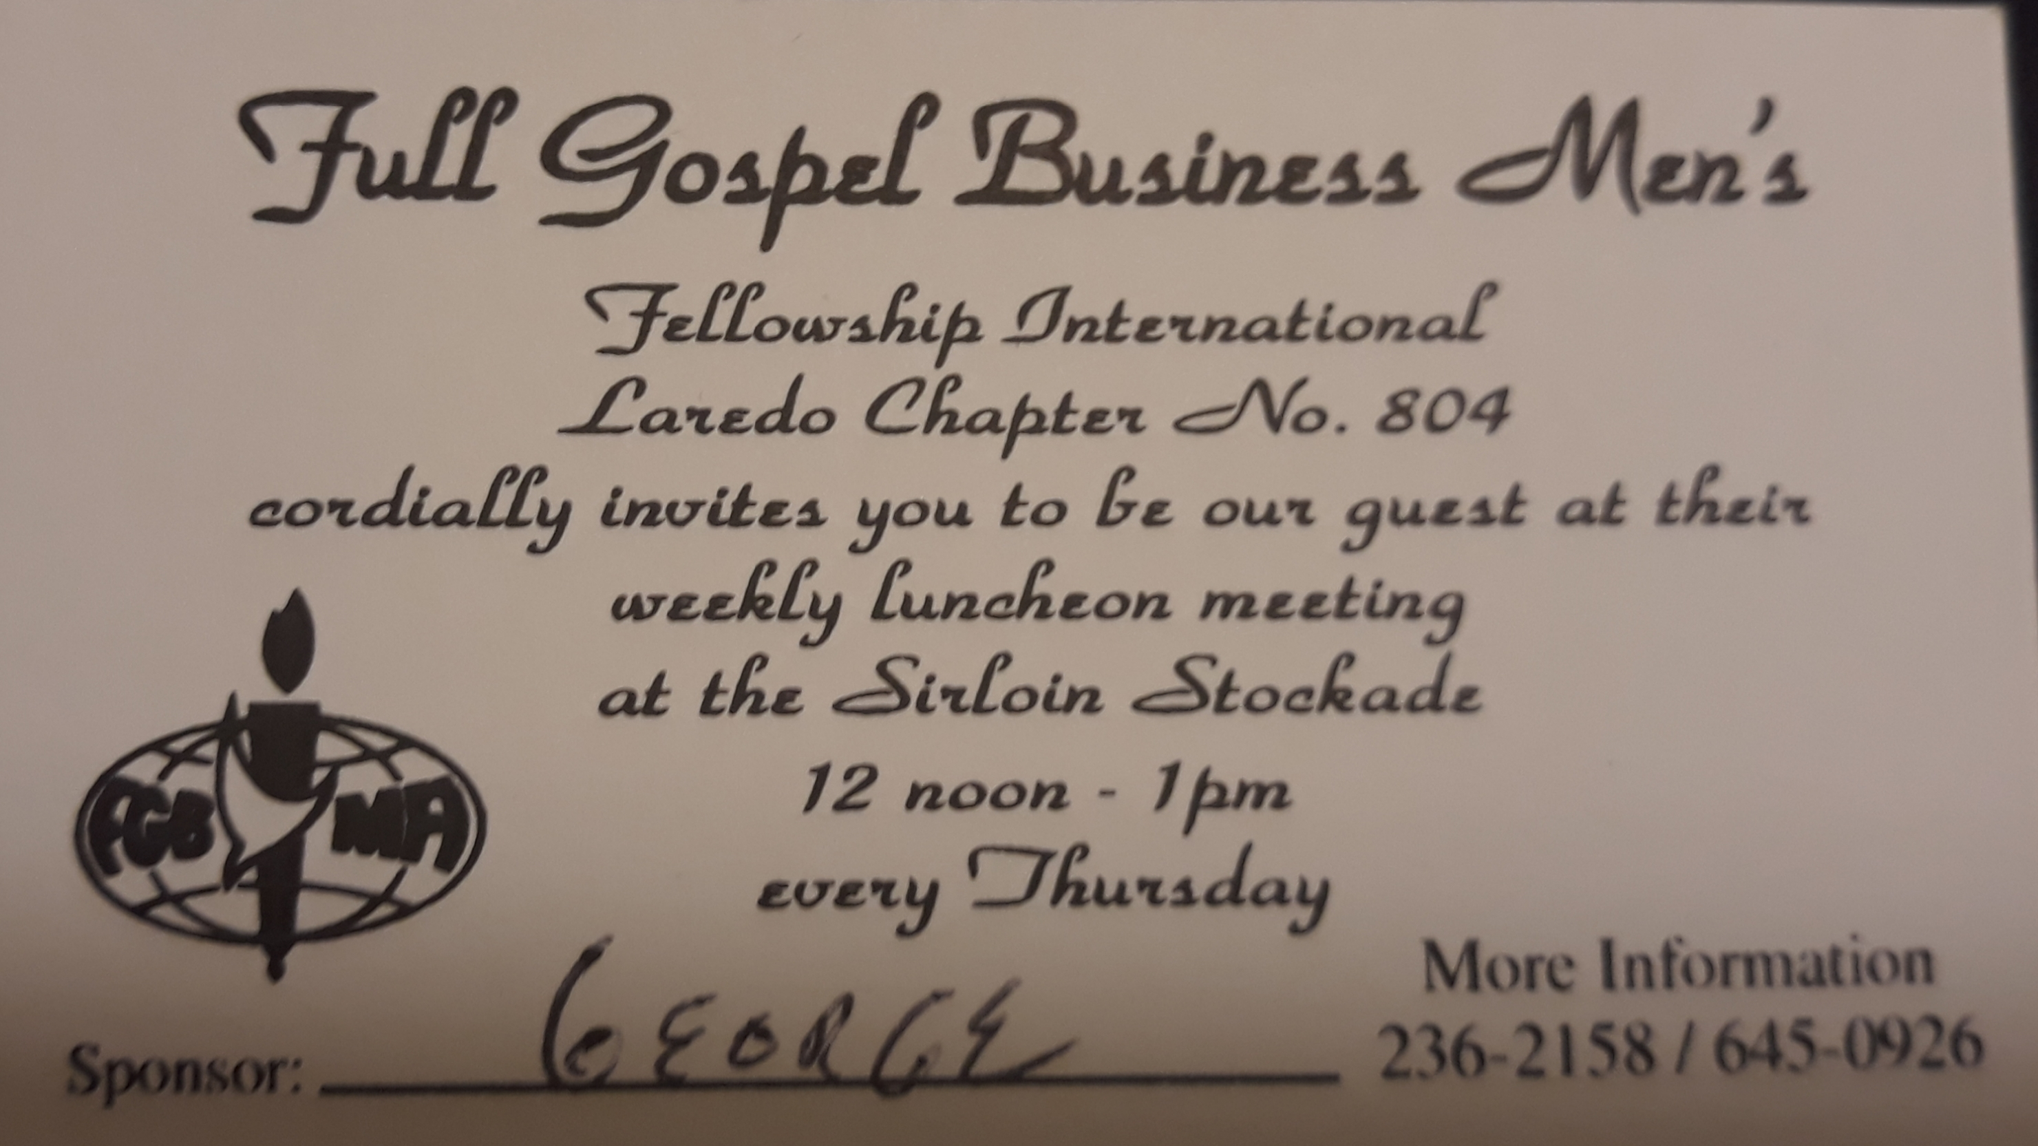
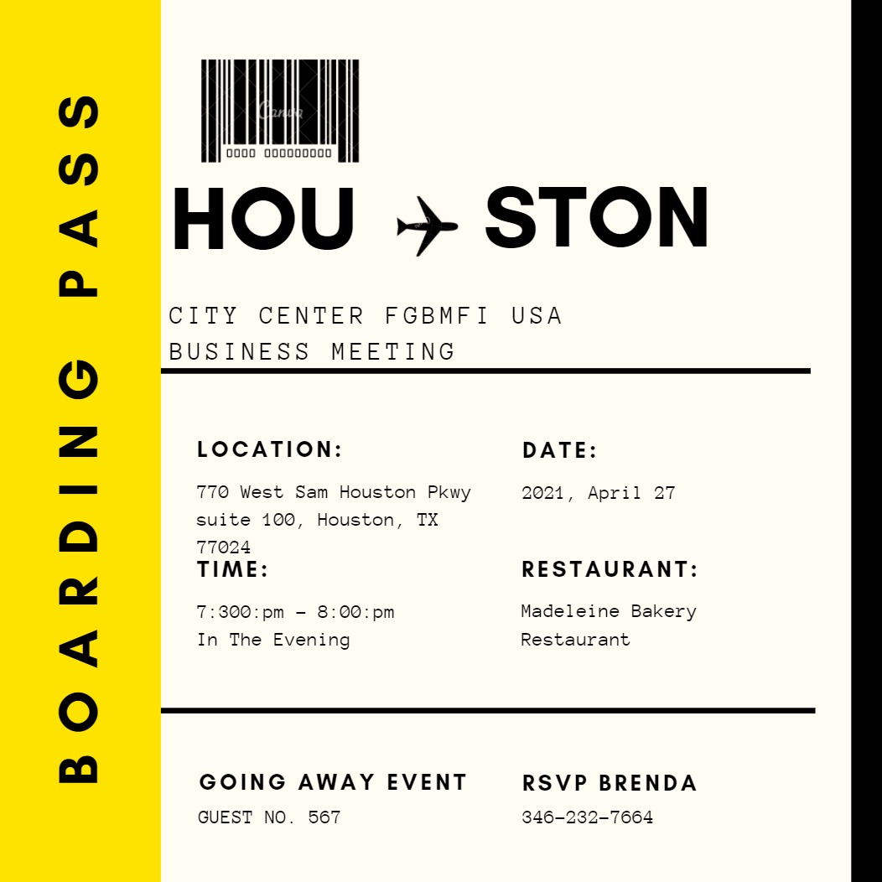
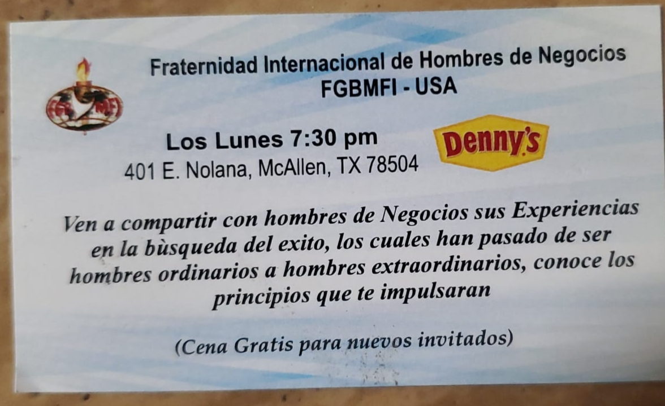
Don’t forget to have some business cards made…Get creative…

Slide 12
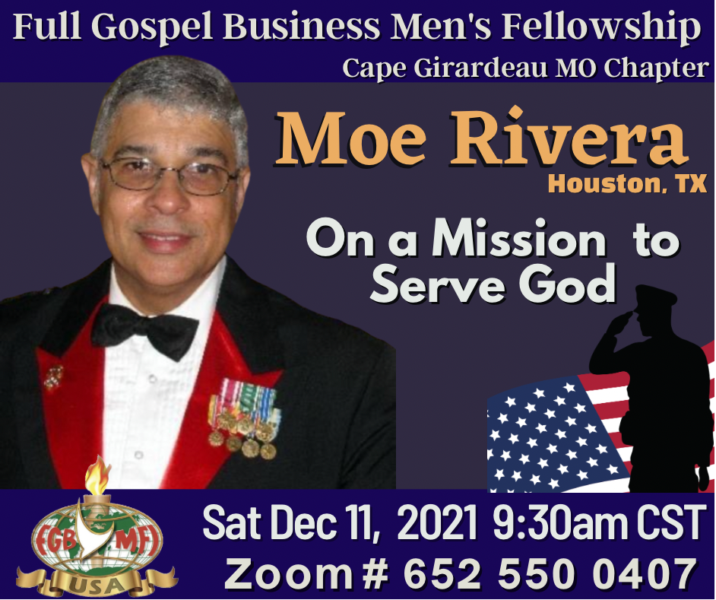
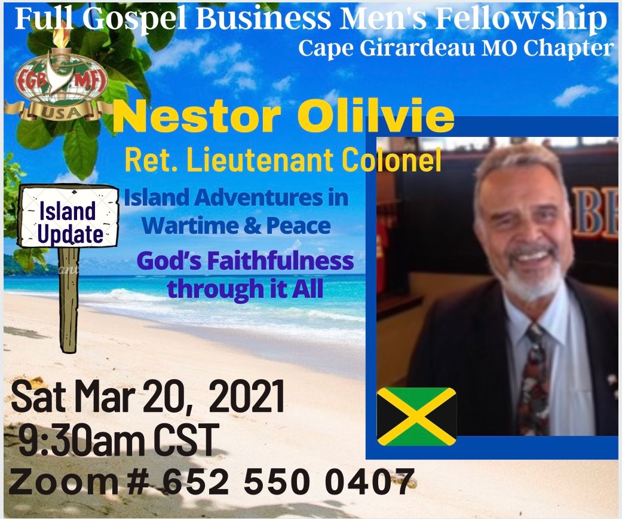
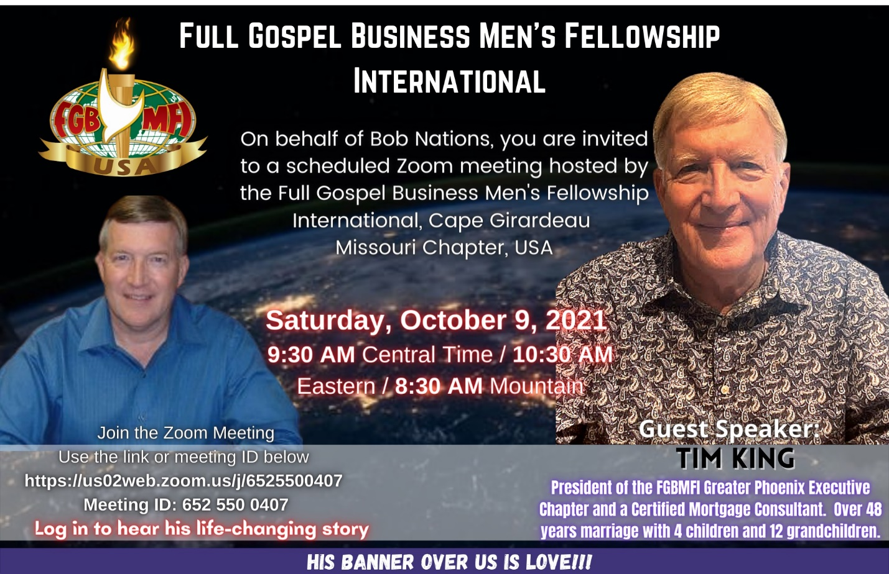
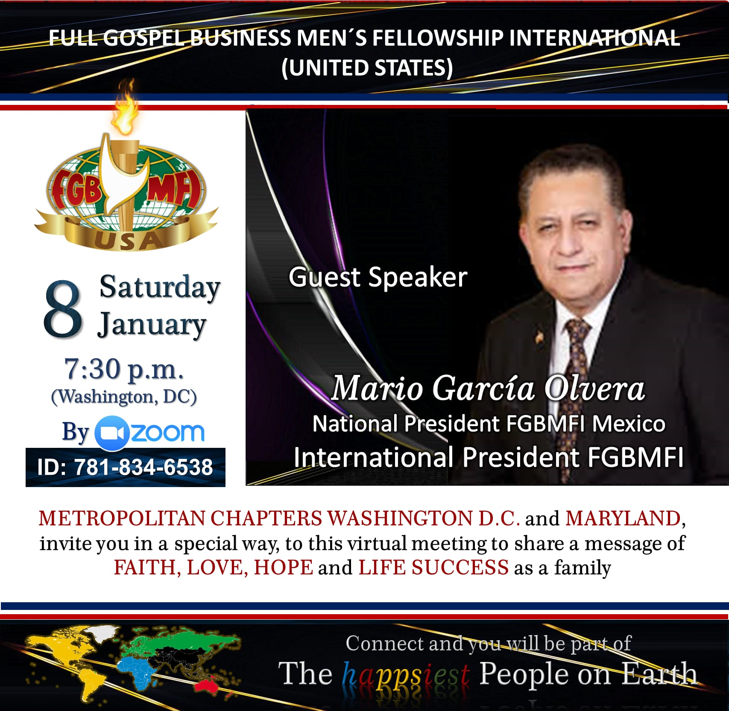
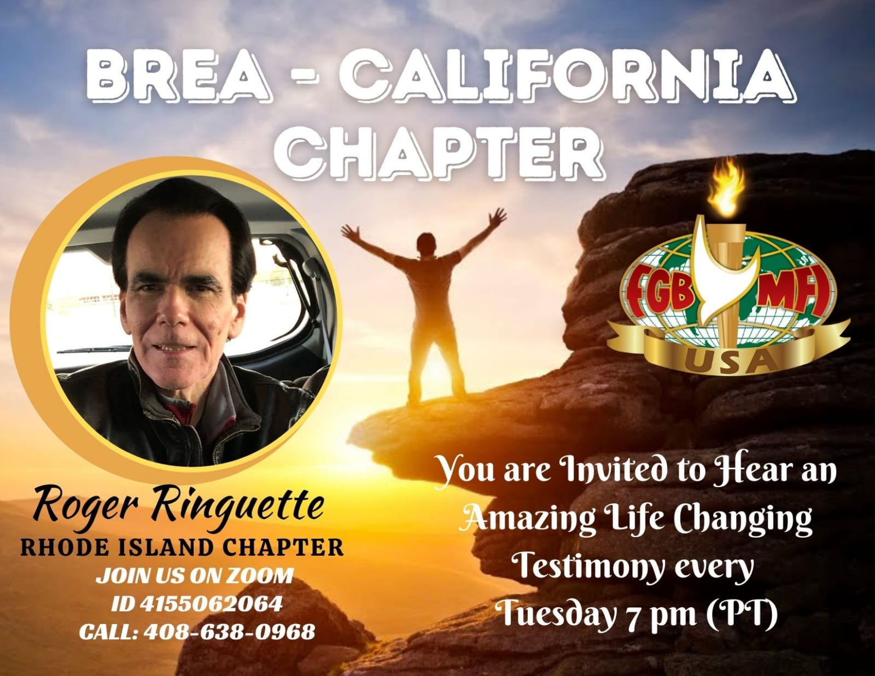
Invite, Invite, invite...there is nothing like a personal invitation to a chapter but we must also learn how to use the media…mini invitation posters that are also sent by text from /to your phone work very well…
r

Slide 13
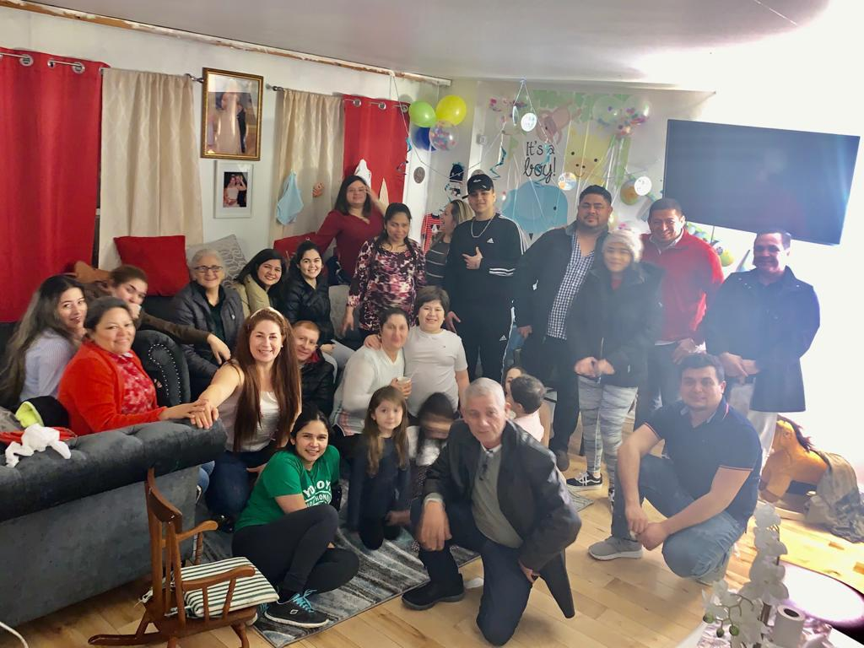
Minister/Pray for the people offering to go to their homes and businesses… ask what part of town they may visiting from…perhaps in the future a chapter can be established there…
In Philadelphia some chapters have been established in people's homes …to begin with…

Slide 14
how a CHAPTER SHOULD OPERATE
Chapter
Closed
Meetings
(Planning &
Prayer )
Outside
Events
(Outreaches)
Expansion
(creating new Chapters)
Training
(Discipleship)
ALTS, Operations, School Of the Vision
Regular
Chapter
Events

Slide 15
Suggested Agenda of the Event
The welcome - “Welcome to the FGBMFI…the largest network of business group of men and women in the world….with chapters in over 95 nations …and what do we do here ? …We share success stories that are going to help and motivate you in your personal life, business life and beyond…but what stories ? Ours.”
“We would like to invite those that are here for the first time to introduce themselves sharing their name, where are they visiting from and what do they do for living.” (as guests introduce themselves, we clap honoring them)
The Announcements.- Any announcements that may be pertinent such as an upcoming event, memberships, books for sale, etc.
We invite anyone who may have a short testimony, an answered prayer to share (5 minutes max.)
We share the Vision of the Fellowship (Demos Vision)
We introduce the main speaker / the testimony …who at the end will invite everyone to pray to receive Christ in their lives/hearts.
We pray for the needs of the attendees. Healing, etc. Allow the Holy Spirit to guide you.
A good MC is always in control.

Slide 16
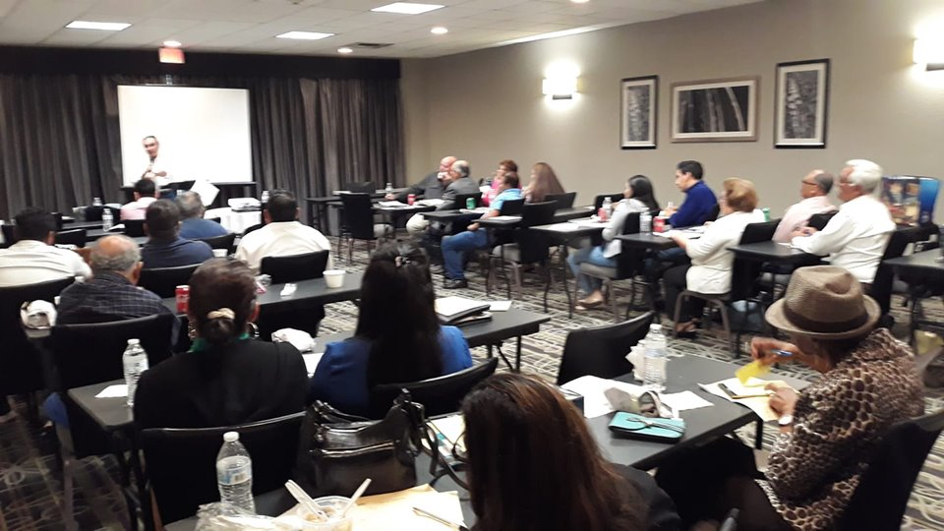
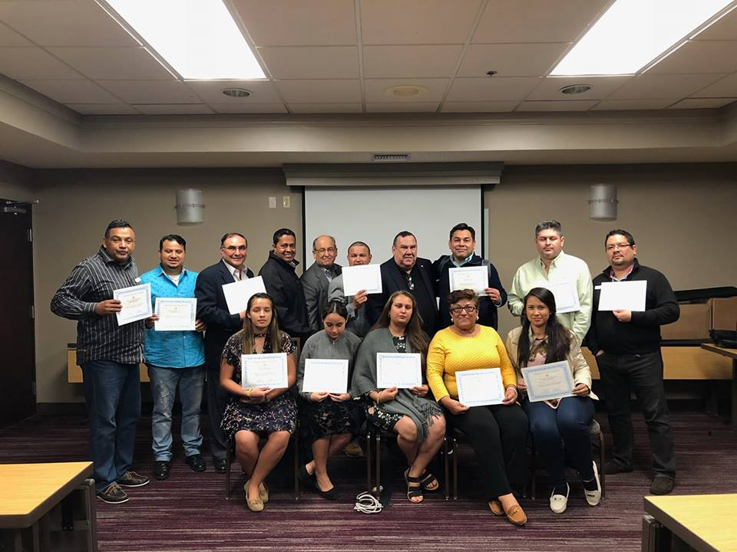
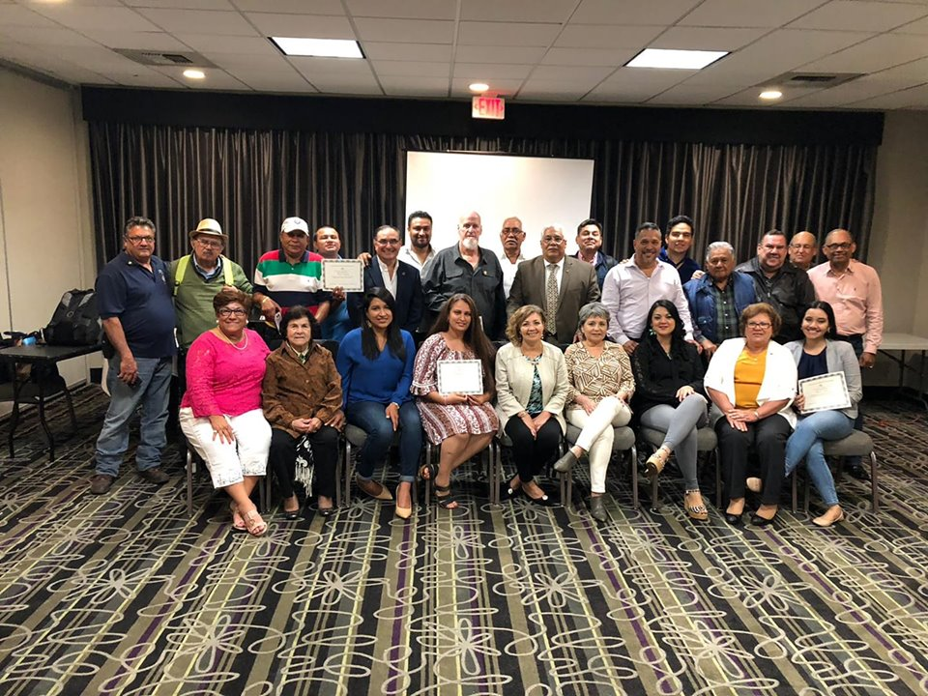
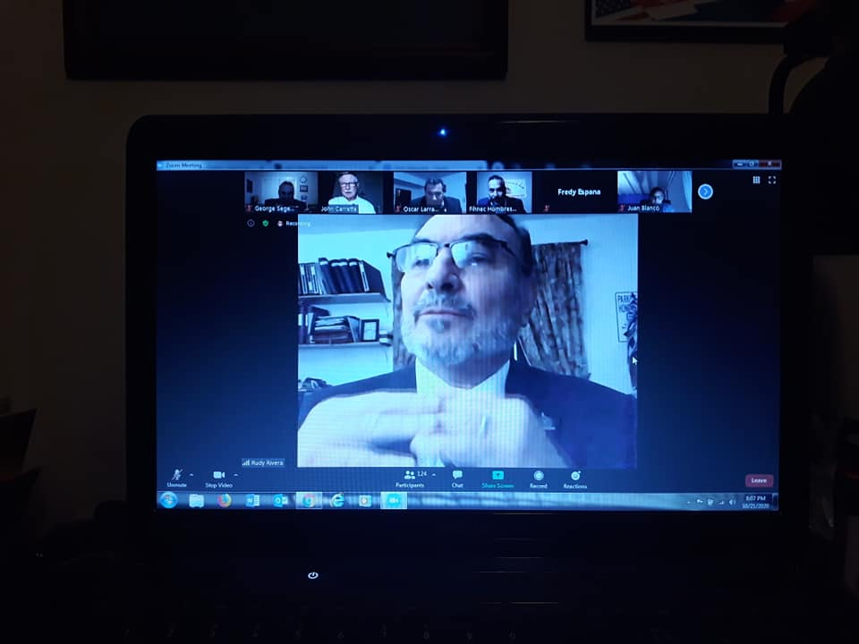
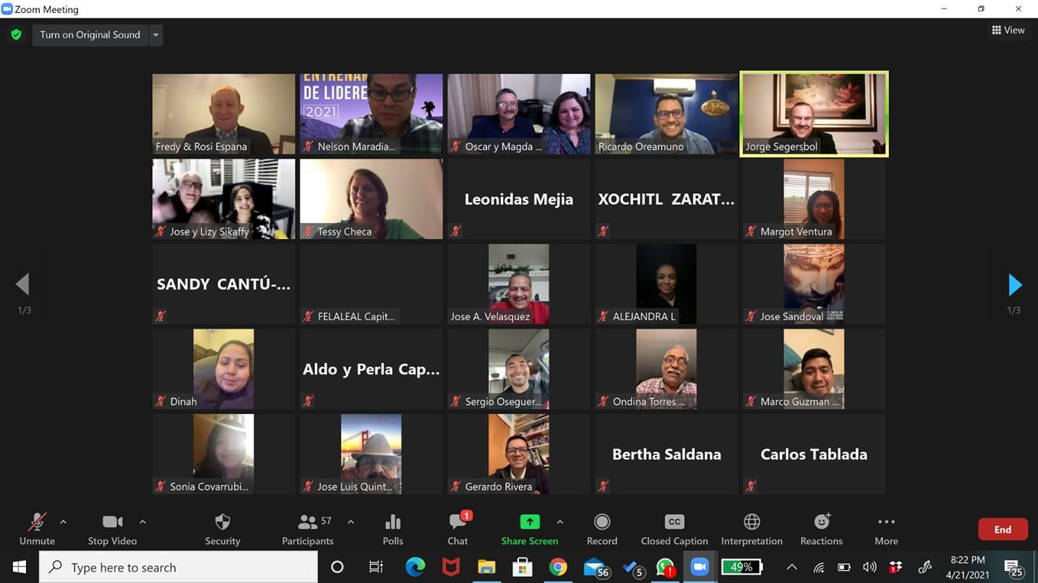
Discipleship
Training others to understand …and to better serve him

Slide 17
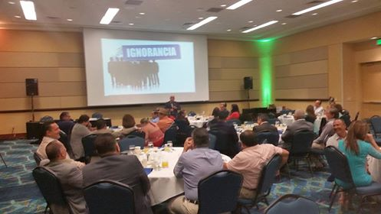
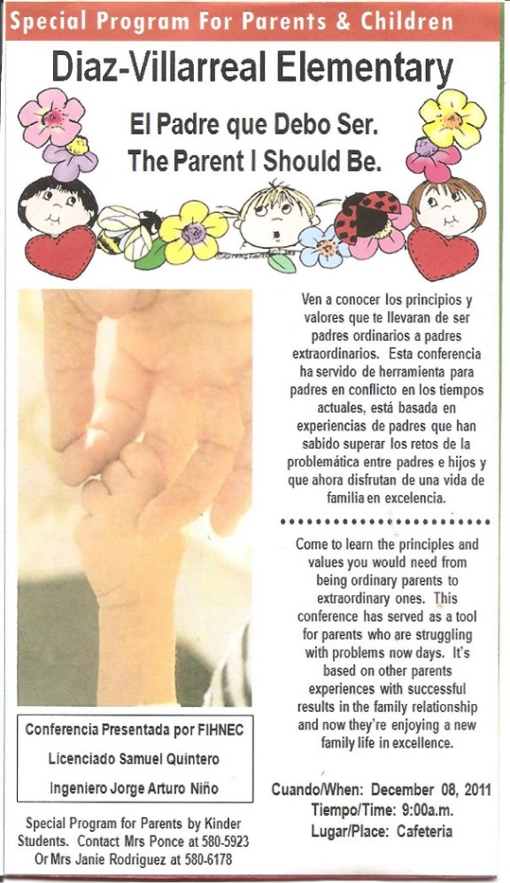
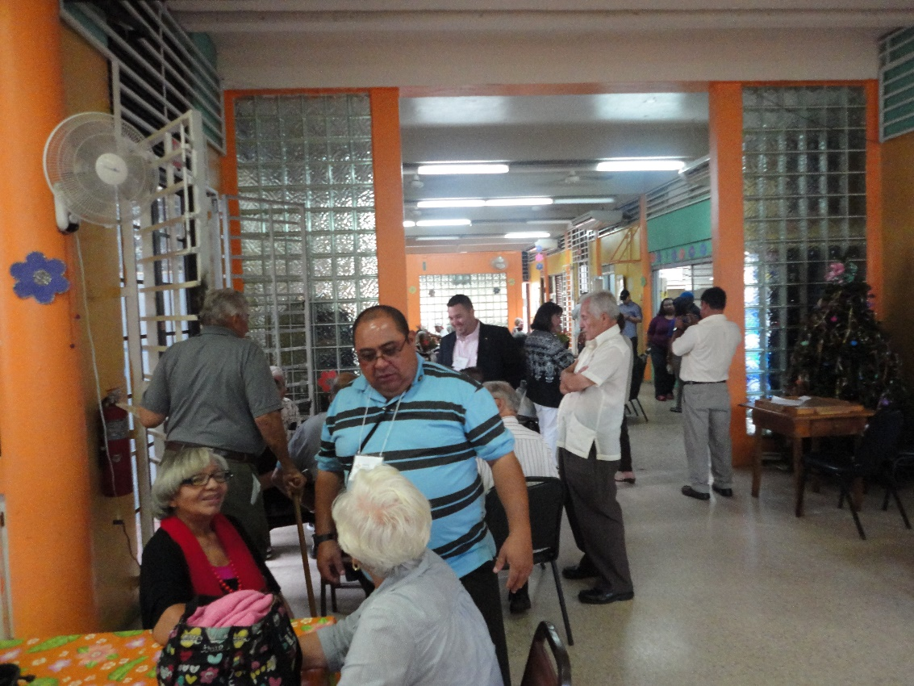
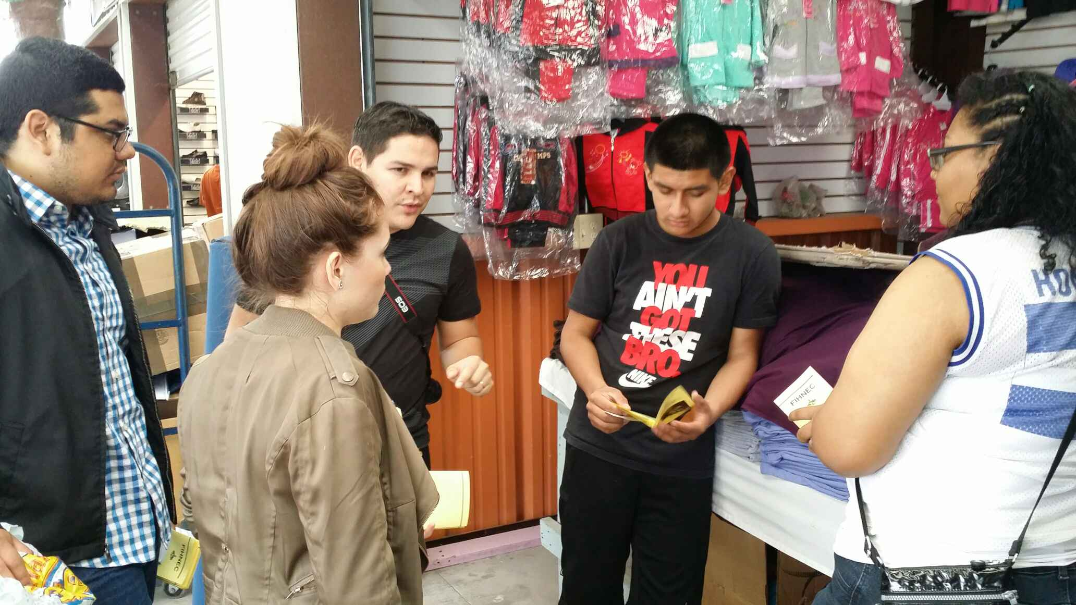
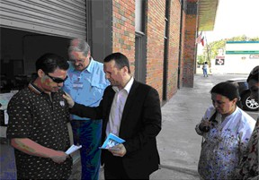
There are different types of Special Events…Allow the Holy Spirit to guide you…(Business seminars on principles and values, at retired homes, flea markets, schools, outreaches with small businesses, etc.)

Slide 18
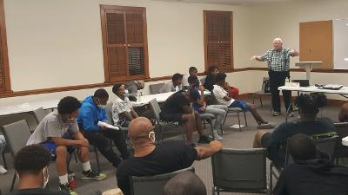
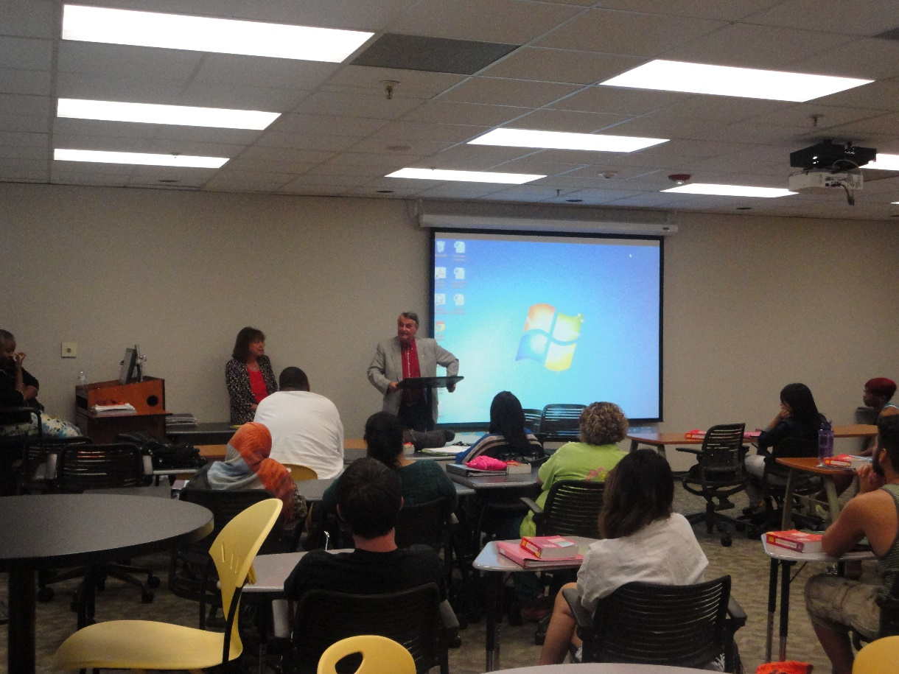
Mike Postlewait, our USA President, teaching the youth in Fort Caswell , North Carolina about Agape Love and how to better understand each other.
Sharing our testimonies at the Houston Community College…What ? In a Public School?... We had to go through the Students Associations…The Lord opened the doors… don’t limit God……….. please

Slide 19
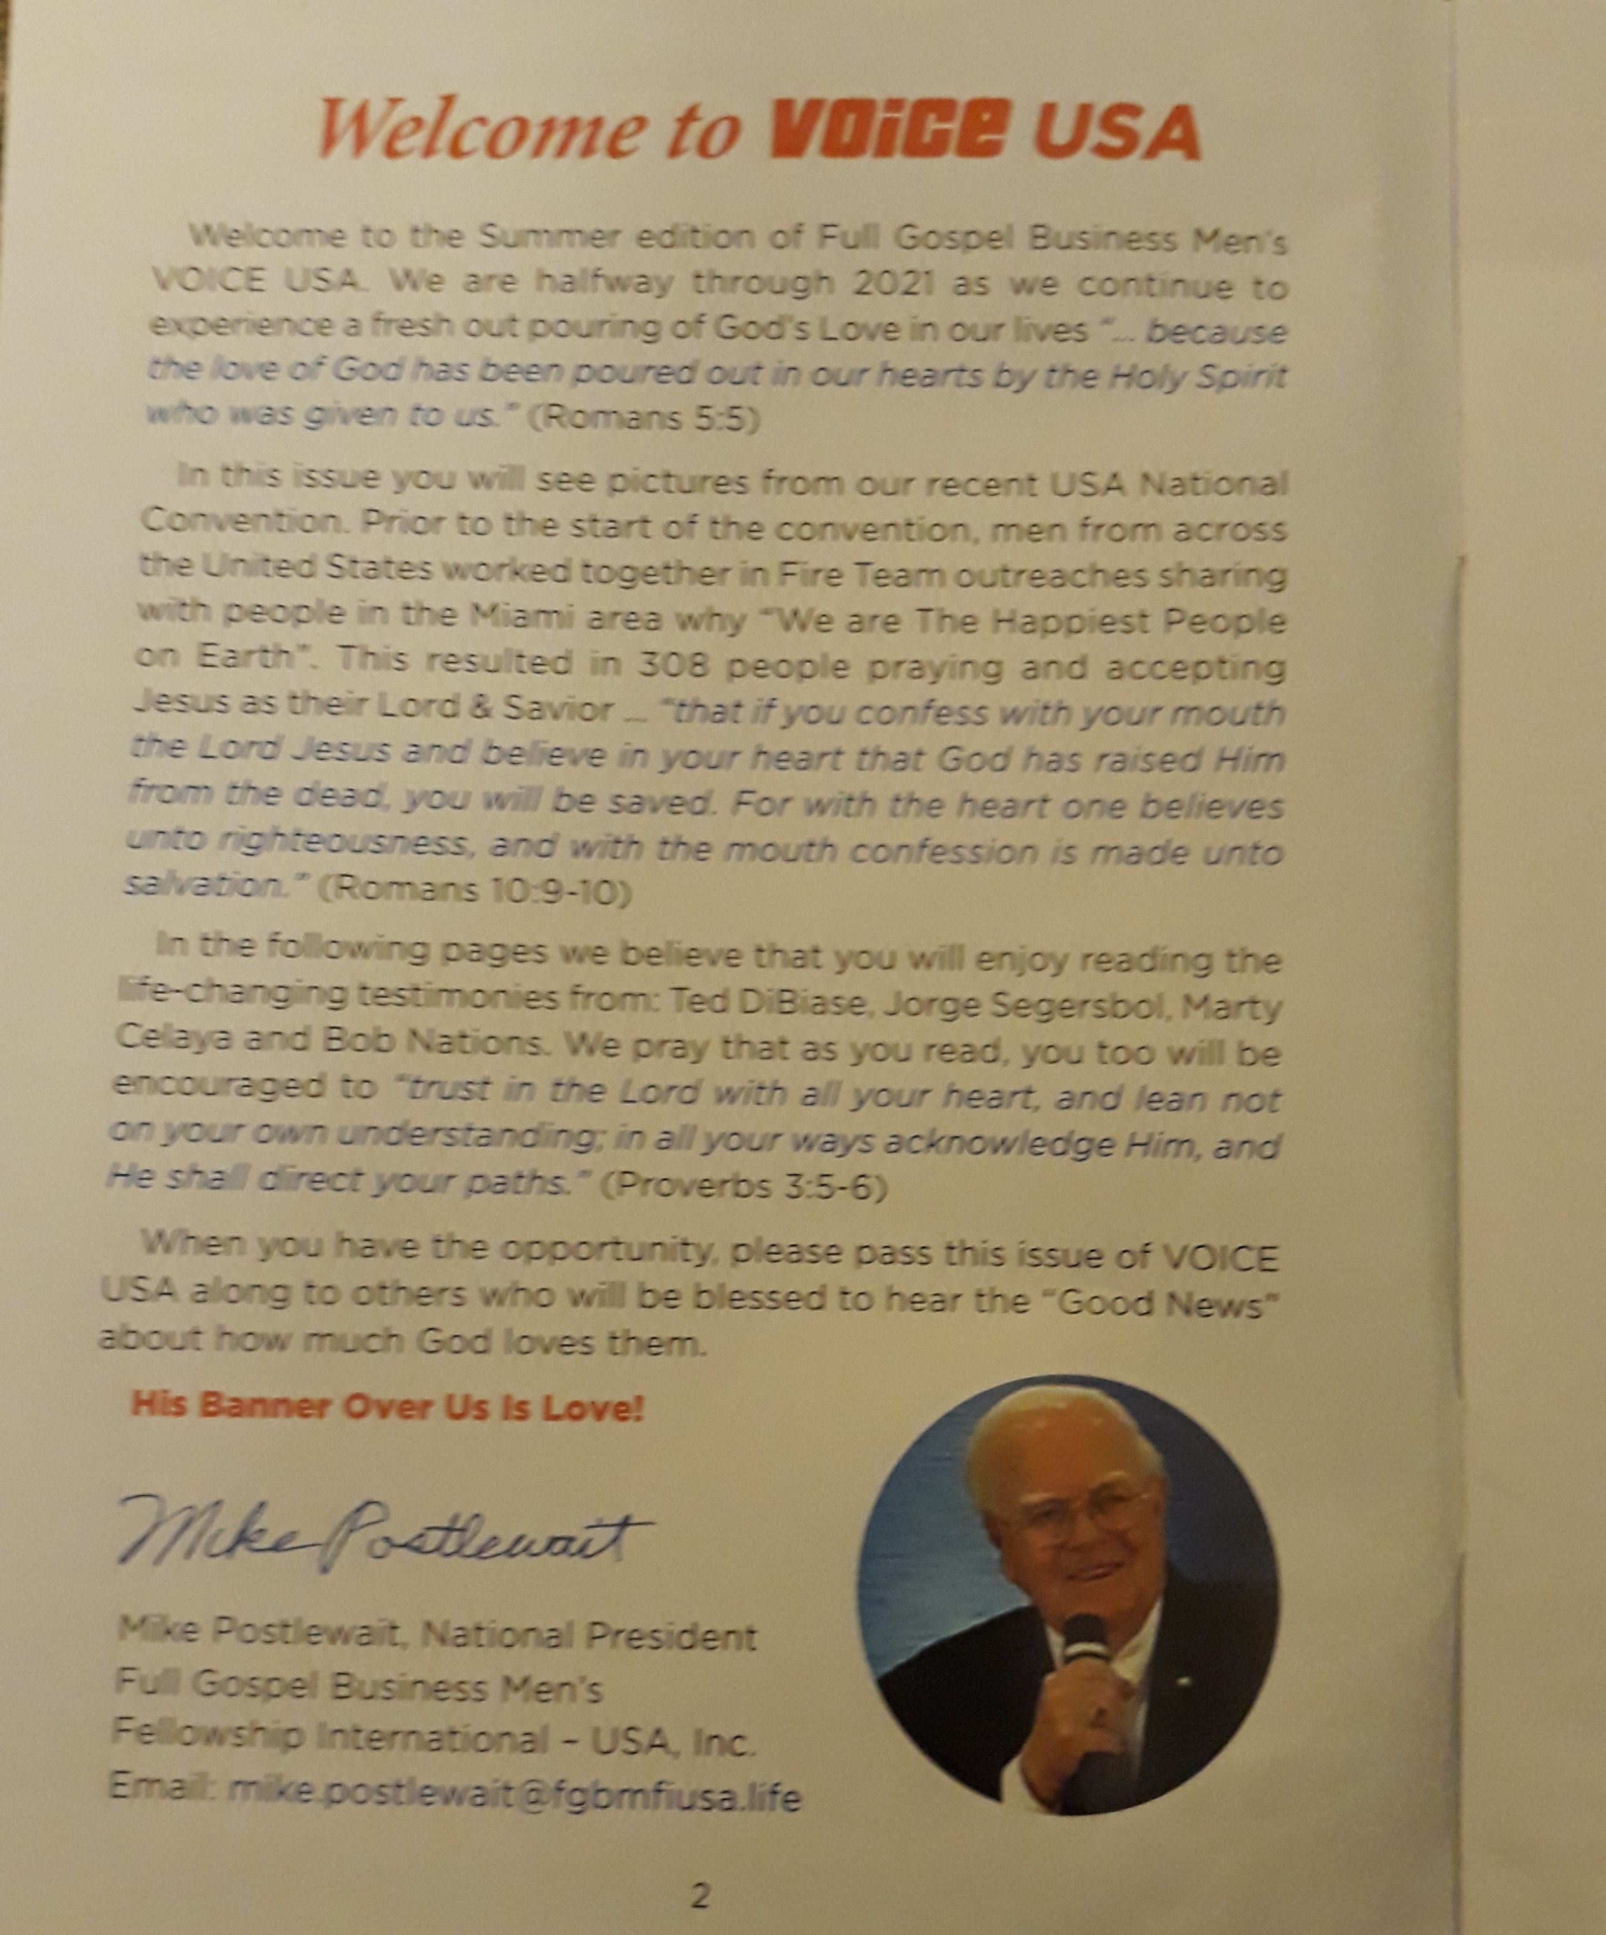
Voice Magazine a wonderful tool for evangelization
Pass them out at buss terminals, doctors offices, retirement homes, universities, business events….give one to every person that comes to your chapter for them to take home…they come in English, Spanish and now in Chinese
Voice Magazine
A wonderful tool for evangelization. Pass them out at buss terminals, doctors offices, retirement homes, universities, business events….give one to every person that comes to your chapter for them to take home…they come in English, Spanish and now in Chinese

Slide 20


Each new chapter president gets these books from our main office

Slide 21
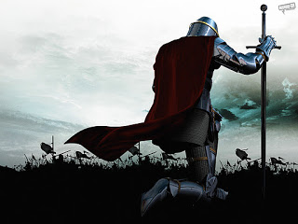
Pray every day that the lord will use you ….reach out and touch someone…

Slide 22
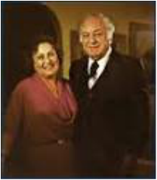
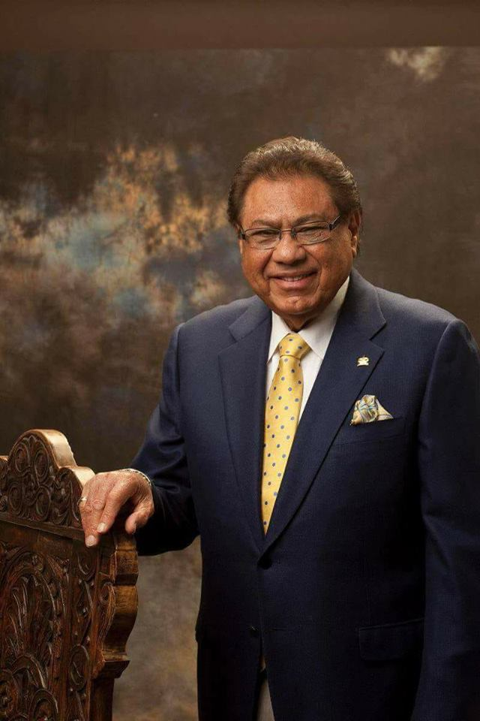
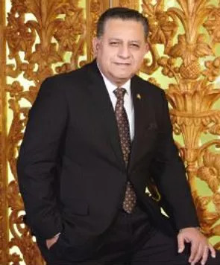
“And He said unto them, Go ye into all the world, and preach the gospel to every creature” Mark 16:15
FGBMFI… is our ministry … an arm to the churches
…to reach the lost

Slide 23
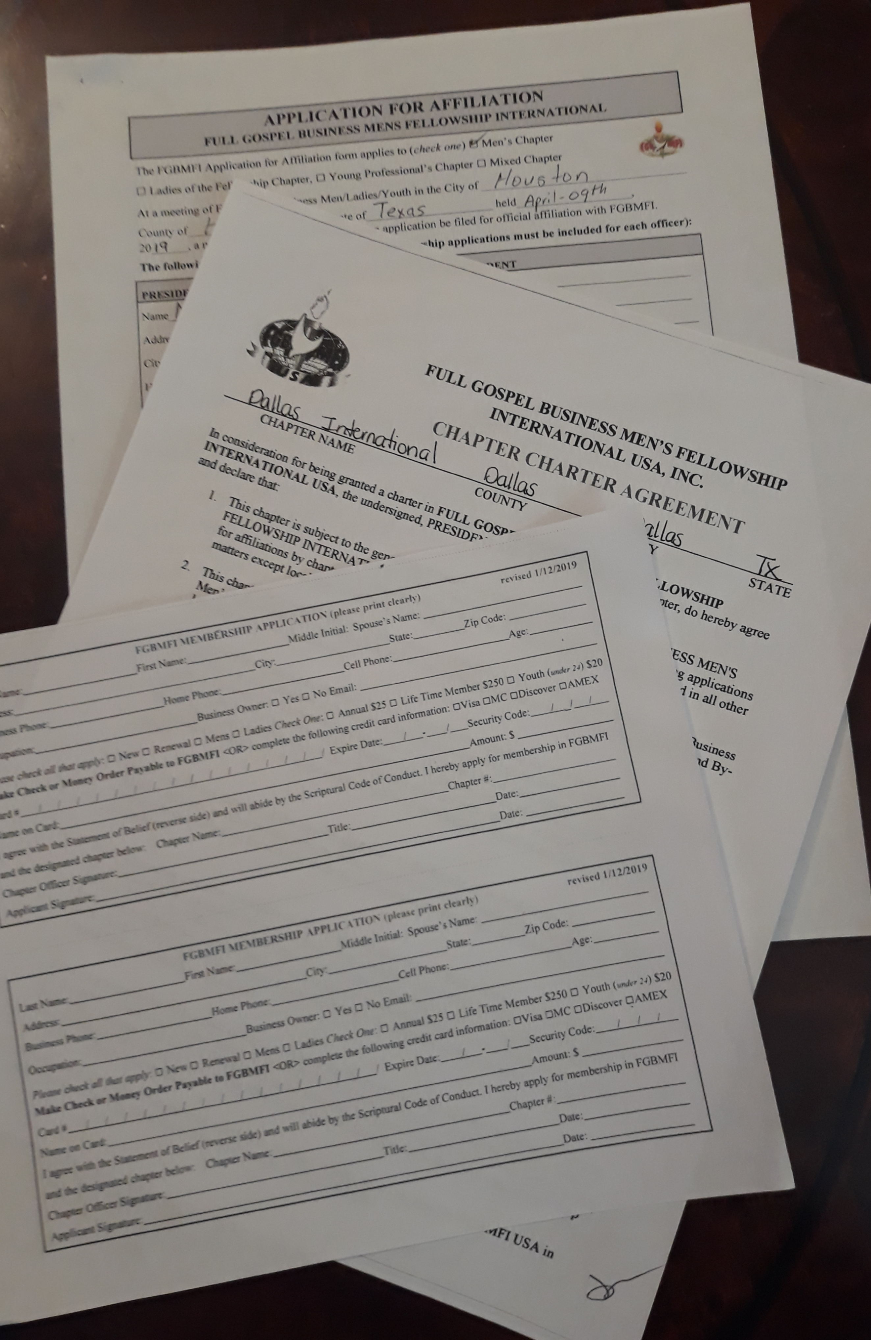
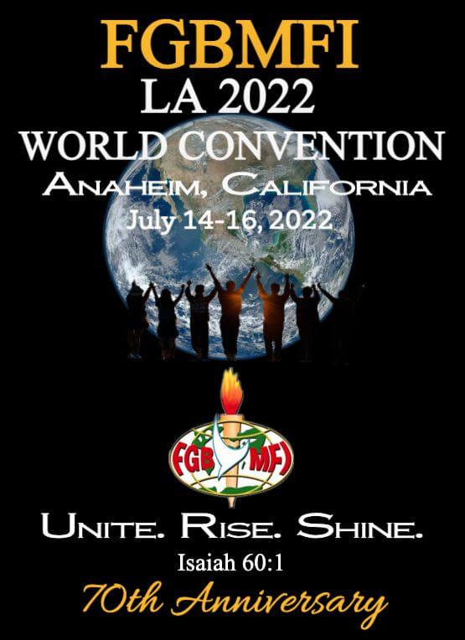
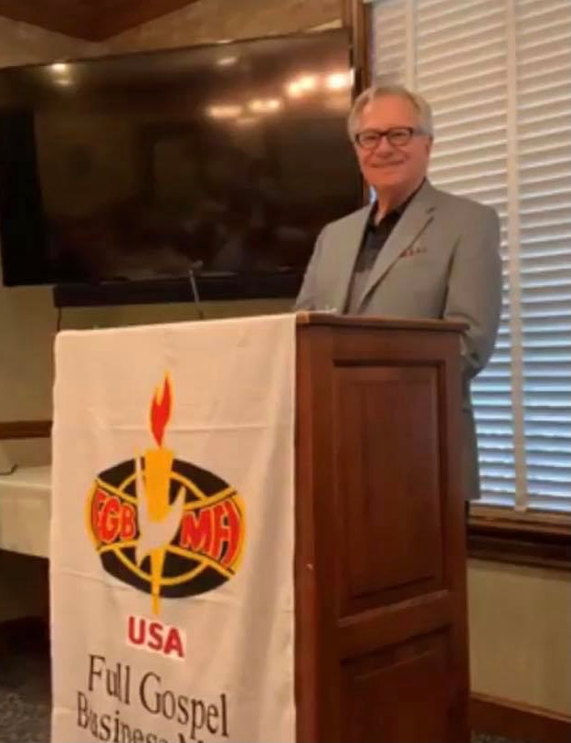
Get the forms at: www.fgbmfiusa.life or
Contact : Ron Bauza
operations@fgbmfiusa.life
(833) 342- 6387

