Slide 1
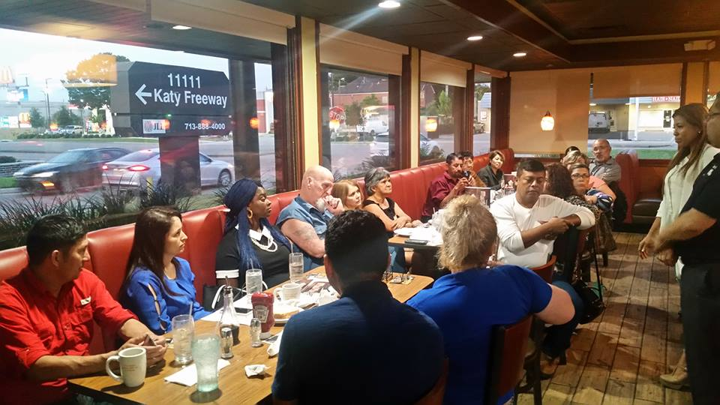
What is a Chapter?
Is a group of members/believers that meet in a neutral place as to share a success story (testimony)…in a business type of atmosphere …nothing religious…no Bibles…so others can come to know our Lord Jesus Christ. We create platforms as to present the Gospel through a testimony.
We are not a church nor we want to be one…
Don’t scare the fish away
We are a layman’s ministry/organization .

Slide 2
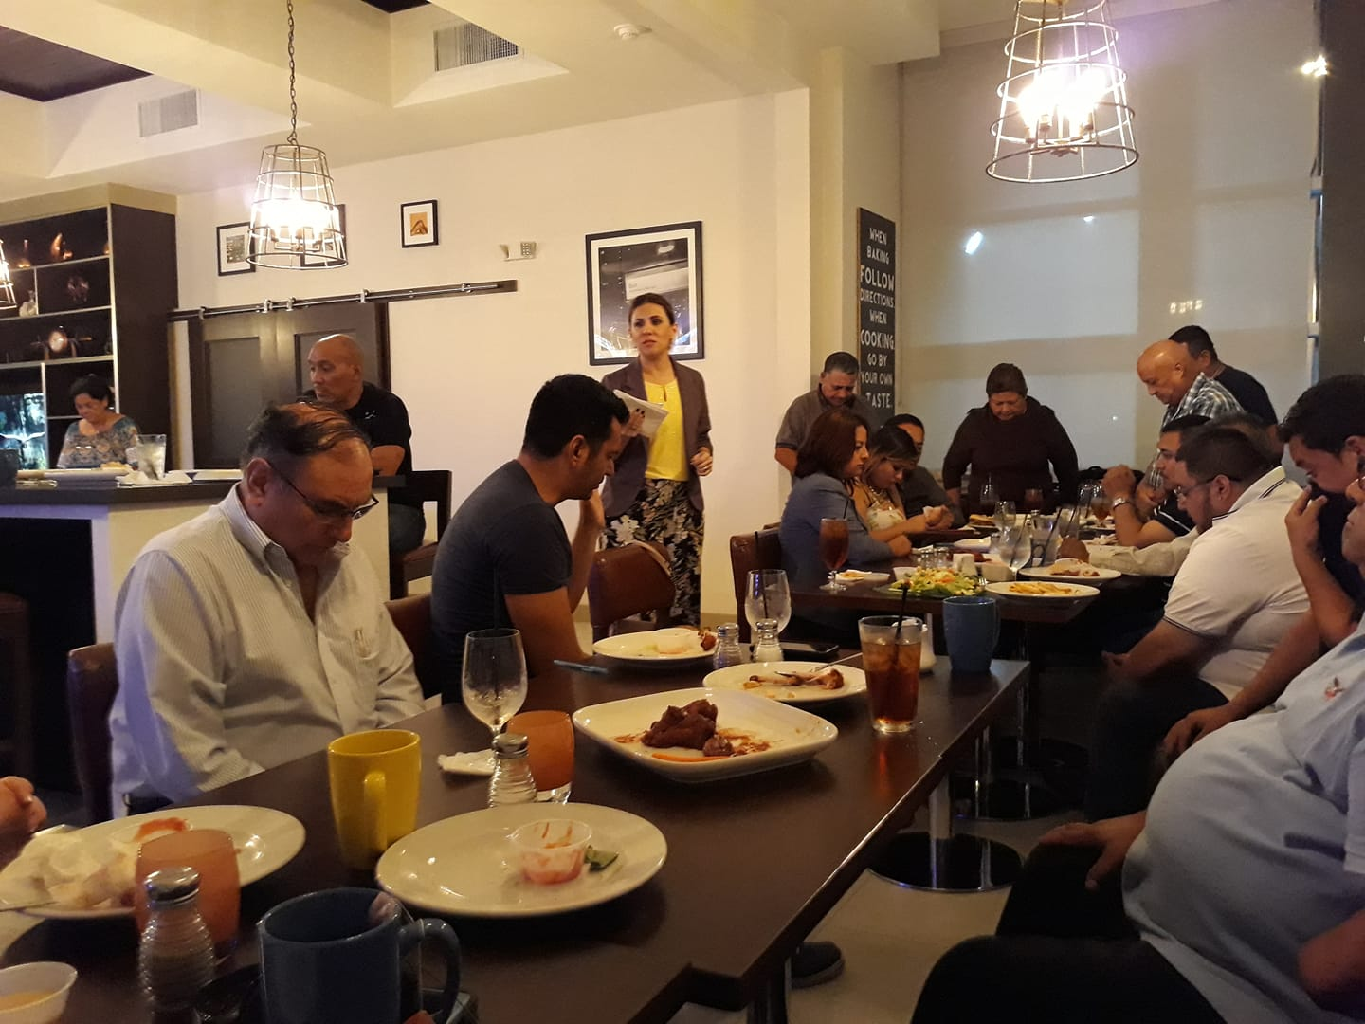
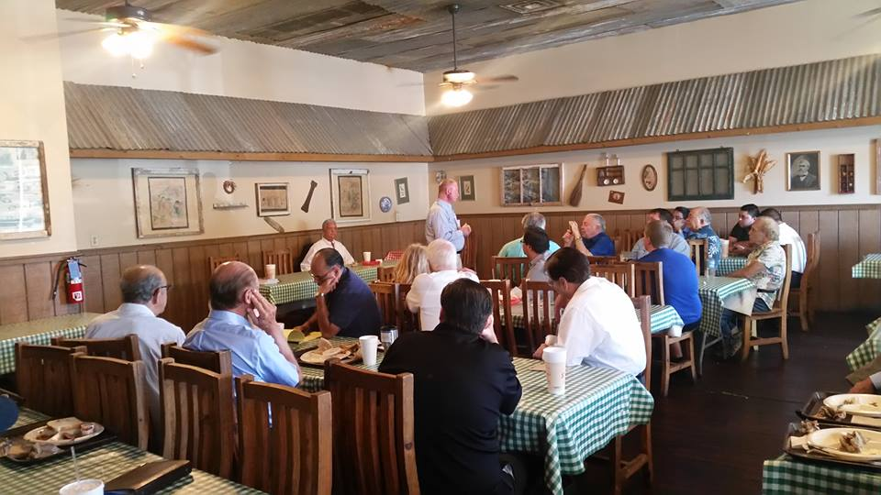
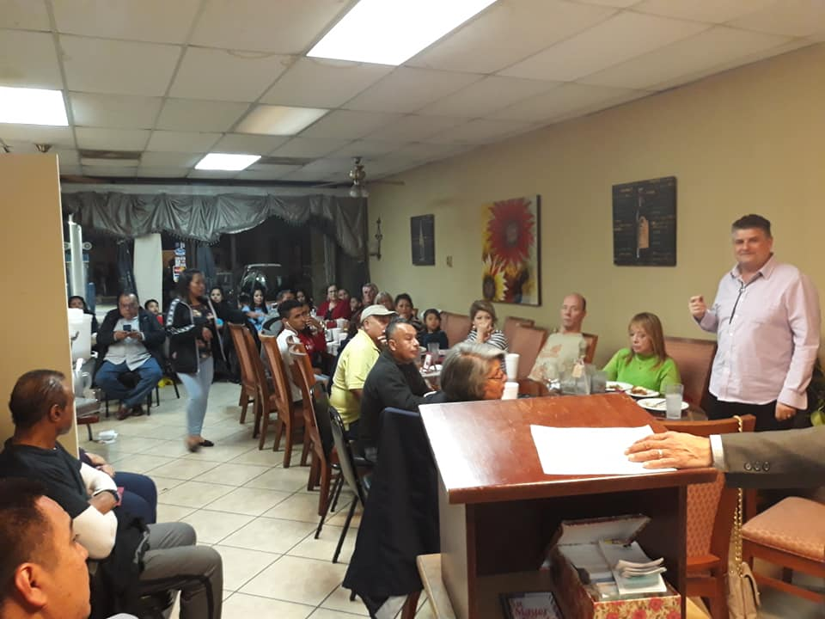
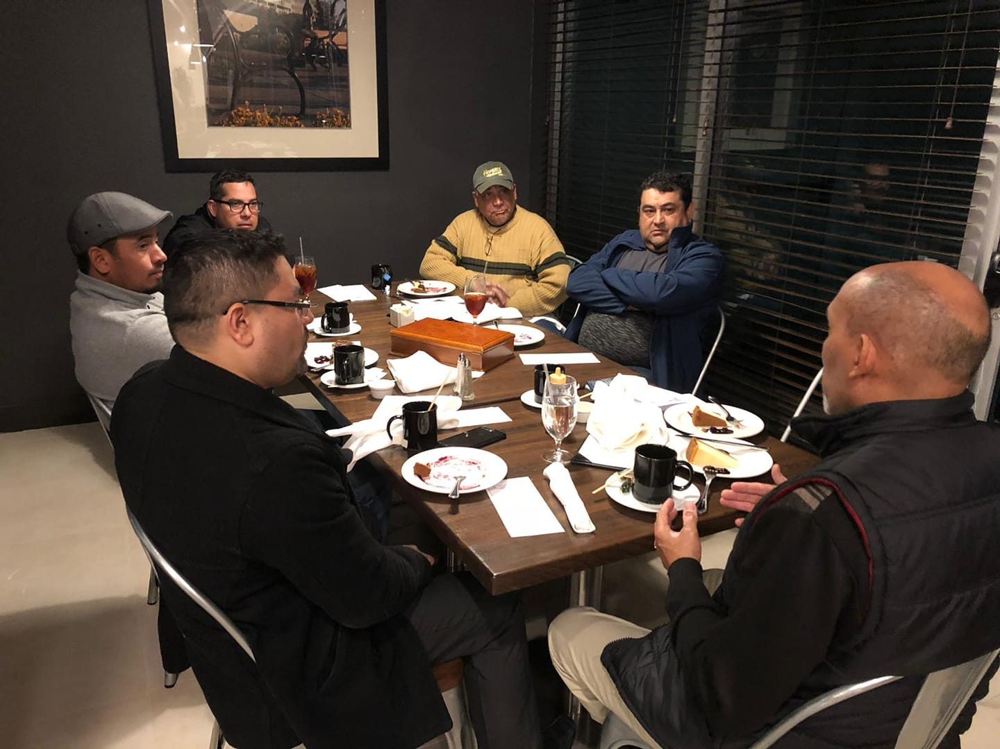
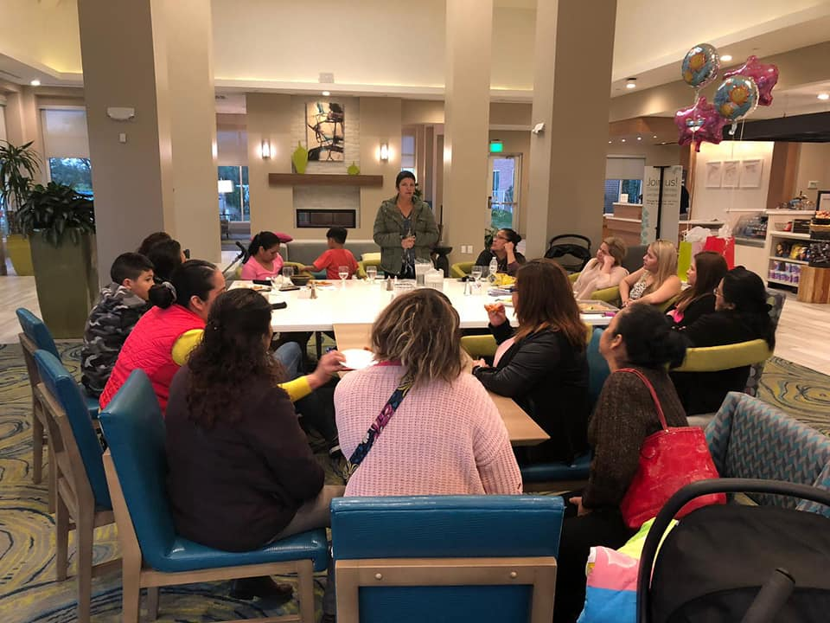
There are many types of chapters, and not two will be the same….the Lord likes the diversity…

Slide 3
Goal of the FGBMFI:
To Win Souls.
… So we custom make/tailor our events according to our audience…including the day of the week and time…among other things…
These meetings are not for us but for the ones that still don’t know whom Jesus Christ is…
We are blessed by listening to the testimonies and by the wonderful fellowship…but these are some of the benefits of serving our Lord…plus many, many more…
…and… a chapter in order to be effective should meet at least twice a month…but we could start with one …a beginning is a beginning

Slide 4
So… The FGBMFI is a strategy and as such we must follow certain guide lines
No preaching…We don’t discuss Theology since we have people/members that come from different denominations/back grounds. We only share/present a Testimony that shows how God can change lives and by doing so we demonstrate that God truly Exists. We do encourage people to attend a church…which one? The one that talks about the Father, the Son and the Holy Spirit …and the one that they feel more comfortable.
We don’t do Bible studies although we encourage the members to read it at home or at their respective churches.
We all love God and we would like to praise and worship Him …and there is nothing wrong with that but this is not the place…
We pray and invite the Holy Sprit to attend before the guests arrive. At the end of the event we pray for anyone that has a need…but at the end…after the testimony and the “altar call” or Invitation to the Cross/Christ.

Slide 5
How do we organize ourselves?
Every chapter should have:
A President.- That ensures that the chapter is fulfilling the mandate, the vision, the mission and the Strategy of the FGBMFI. He has the Spiritual responsibility. He elects or approves the guest speakers…he is responsible for the finances…he must have received the baptism of the Holy Spirit. We can also have a Vice president that can assist in every aspect of the functioning of the chapter/event.
A Secretary .- He/She maintains all the chapter records, assists the president in every aspect of the chapter operations, is responsible for all the chapter advertising, websites and all updates. He/She must also have received the baptism of the Holy Spirit.

Slide 6
A Treasurer.- Whom is responsible together with the president for the finances. Must keep a good record of the expenditures / receipts of the paid expenses as well as all the offerings, deposits, and monthly donations to the USA main office.
Other Officers: (not limited to)
Memberships .- Makes sure that these are promoted in every event and keeps up the record of the members, renewal fees, gifts.
Prayer Coordinator.- He/She is responsible for coordinating prayer meetings. Trains and equips members in Spiritual warfare and intercessory.
Outreaches and expansion- Special events coordinator whom seeks and plans fire teams events and seeks new places to start chapters.
Books.- Makes sure that there is always books, magazines in the chapter for the members and new comers growth. Coordinates the purchases with the president and treasurer.

Slide 7
Sometimes it takes time…a tree must first develop a strong root system as to resist strong winds that may come ahead…

Slide 8
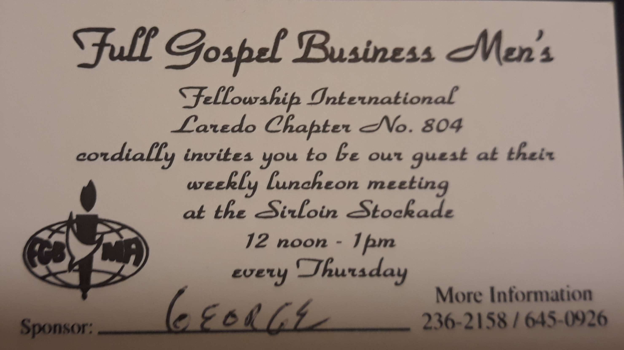
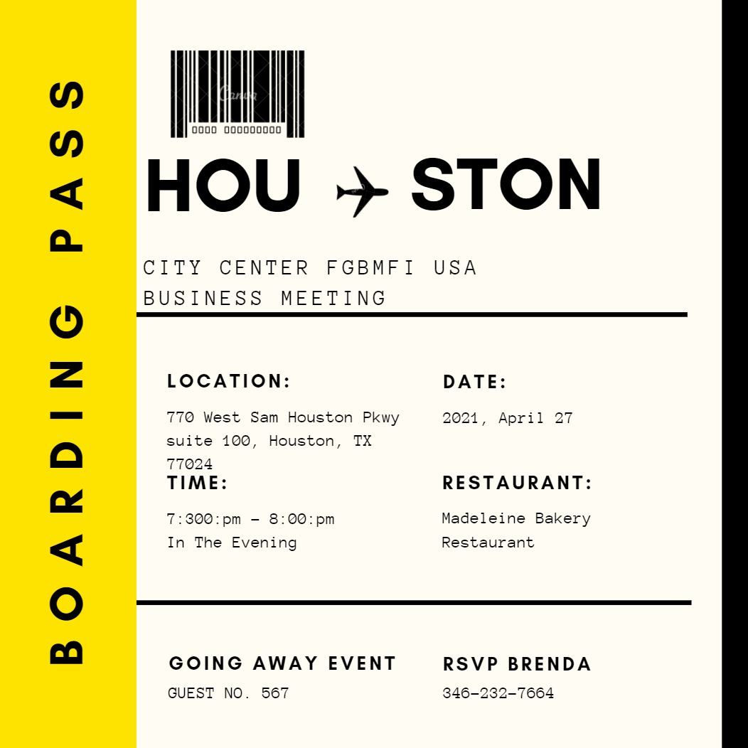
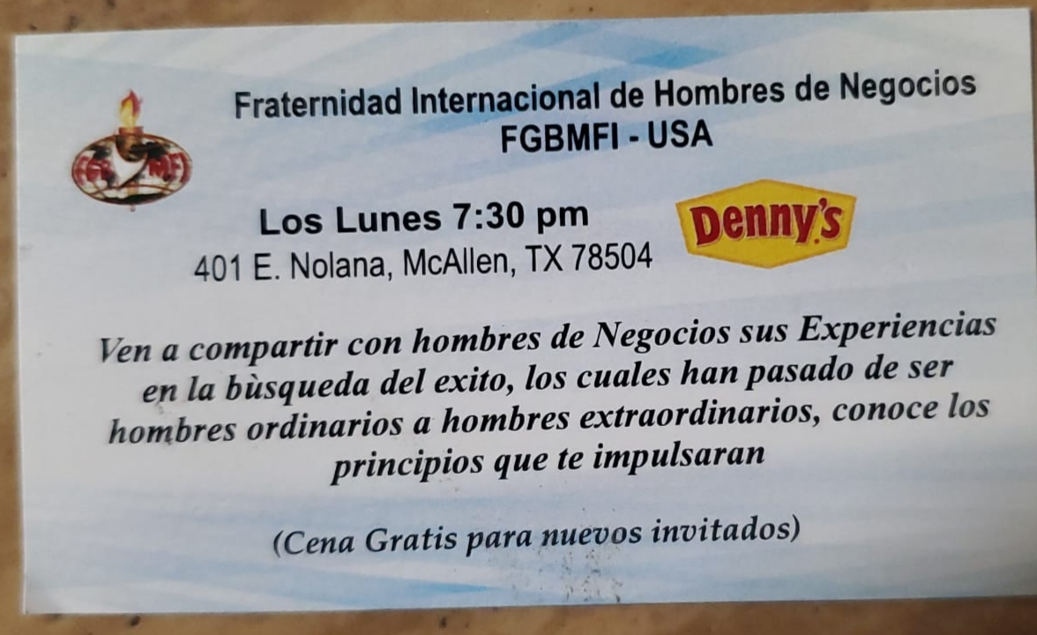
Don’t forget to have some business cards made…Get creative…

Slide 9
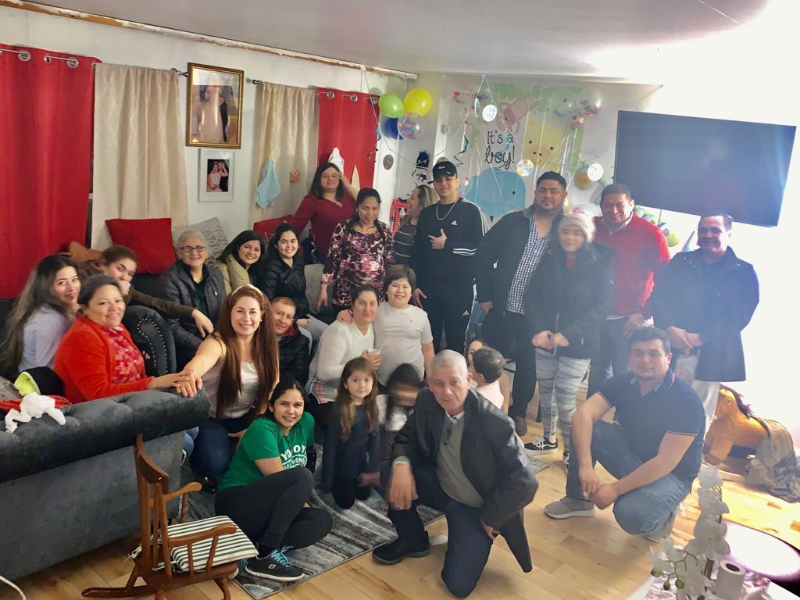
Minister/Pray for the people offering to go to their homes and businesses… ask from what part of town are they visiting from…perhaps in the future a chapter can be stablished there…
In Philadelphia some chapters have been established at peoples homes …to begin with…

Slide 10
how a CHAPTER SHOULD OPERATE
Chapter
Closed
Meetings
(Planning &
Prayer )
Outside
Events
(Outreaches)
Expansion
(creating new Chapters)
Training
(Discipleship)
ALTS, Operations, School Of the Vision
Regular
Chapter
Events

Slide 11
the Agenda of the Event (suggested)
The welcome .- “Welcome to the FGBMFI…the largest business group of men and women in the world….with chapters in about 95 nations …and what do we do here ? …We share success stories that are going to help and motivate you in you personal life, business life and beyond…but what stories ? Ours”.
“We want to invite the ones that are here for the first time to introduce themselves sharing their name, where are they visiting from and what do they do for living.” (as they guest introduce themselves, we clap honoring them)
The Announcements.- Any announcements that may be pertinent to talk about like for example an upcoming event, memberships, books for sale, etc.
We invite anyone whom may have a small testimony, an answered prayer to share it (5 minutes max.)
We share the Vision of the Fellowship (Demos Vision)
We introduce the main speaker / the testimony …whom at the end will do the sinners prayer.
We pray for the needs of the attendees / Let the Holy Spirit guide you.

Slide 12
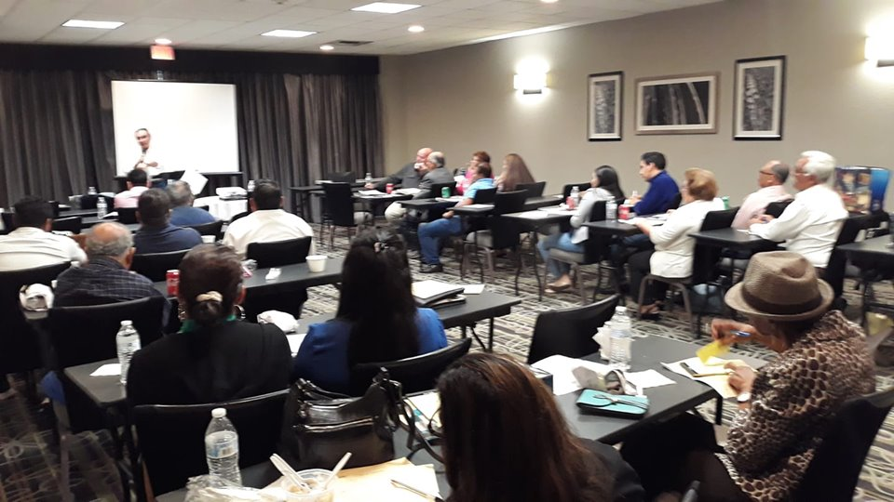
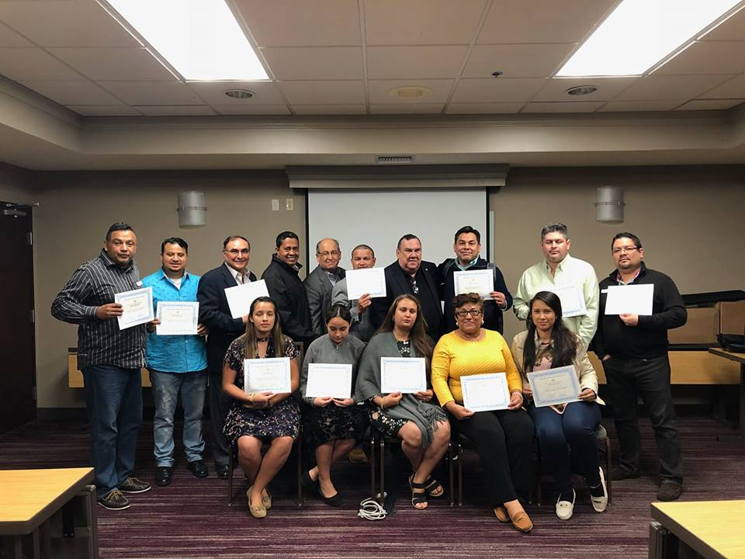
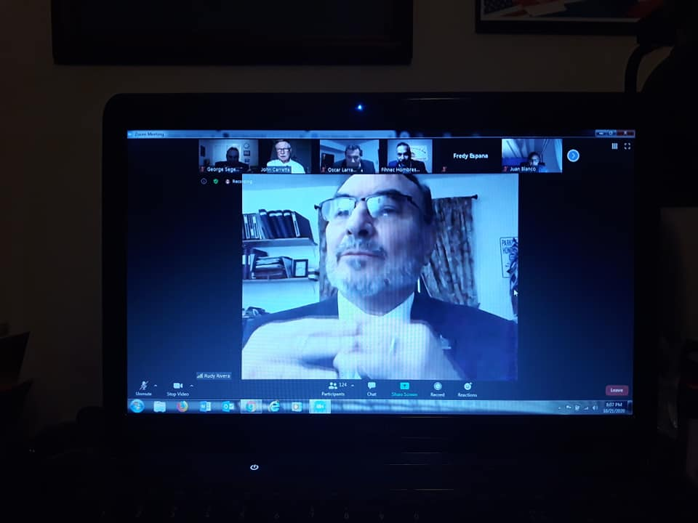
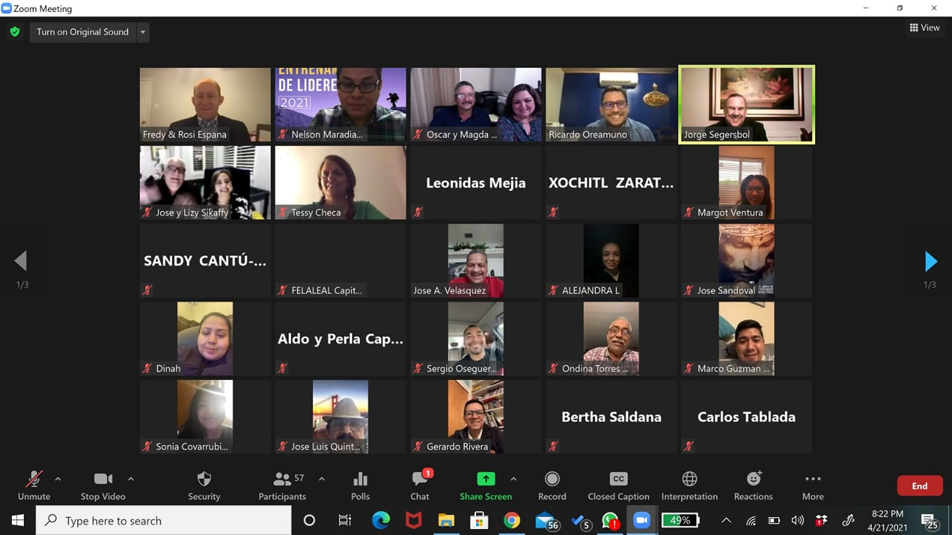
Discipleship Training others to understand …and to better serve him

Slide 13
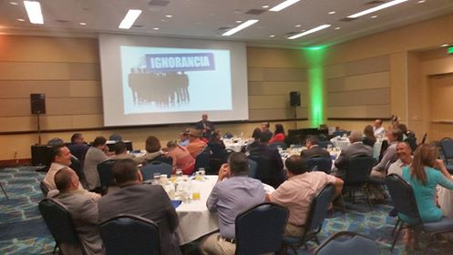
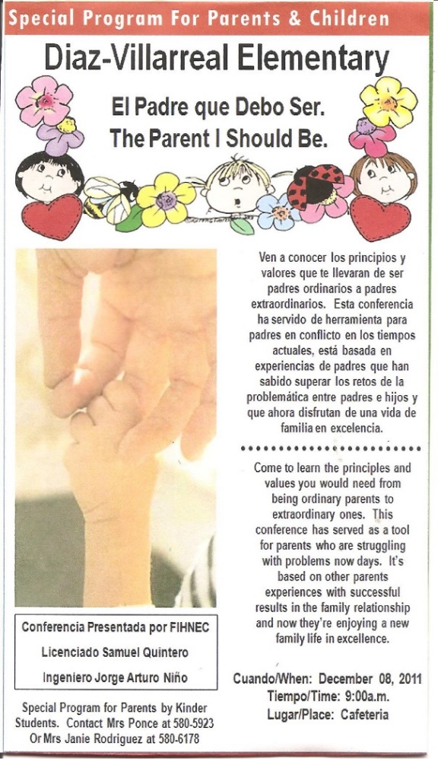
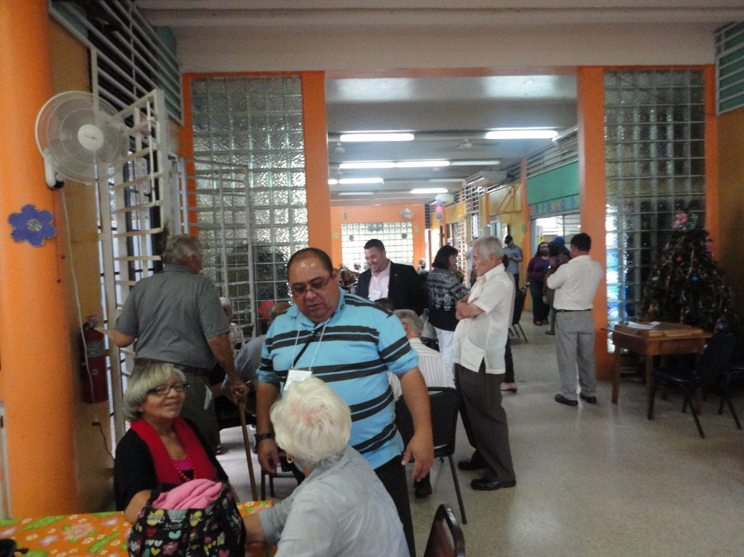
There are different types of Special Events…let the Holy Spirit guide you…( Business men seminars on principles and values, at retired homes, flea markets, schools, outreaches with small business, etc.)

Slide 14
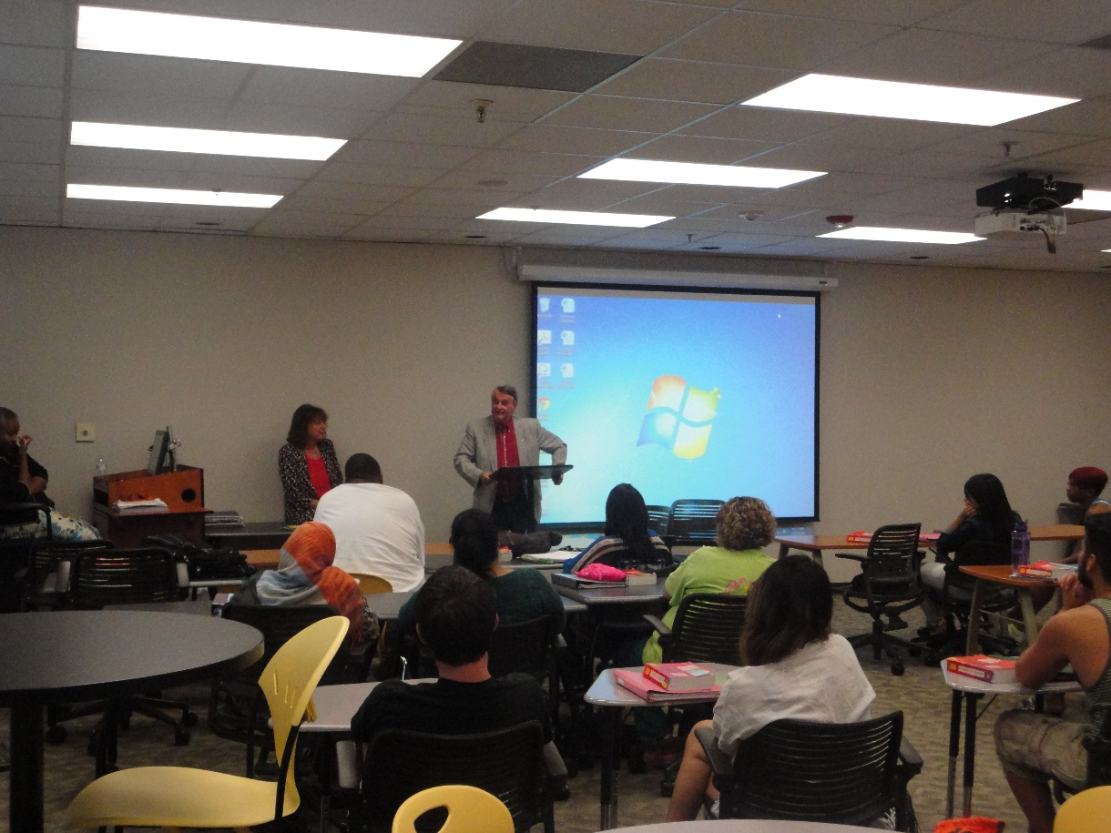
Sharing our testimonies at the Houston Community College…What ? In a Public School?... We had to go through the Student Associations…The Lord opened the door… don’t’ limit god……….. please

Slide 15
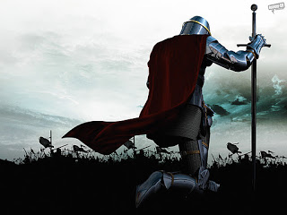
Pray every day that the lord will use you ….reach out and touch someone…

Slide 16
“And He said unto them, Go ye into all the world, and preach the gospel to every creature” Mark 16:15 The FGBMFI… is our ministry … an arm to the churches …to reach the lost

